Slide 1
Segment Routing Bootcamp Lab

Slide 2
Prerequisite
Please access and reserve http://dcloud.cisco.com
Cisco WAN Automation Engine 7.1.1.1 - Segment Routing and XTC Sandbox v1
Please connect dcloud vpn anyconnect and test Telnet Session to every nodes
Please have python 2.7 installed in the laptop

Slide 3
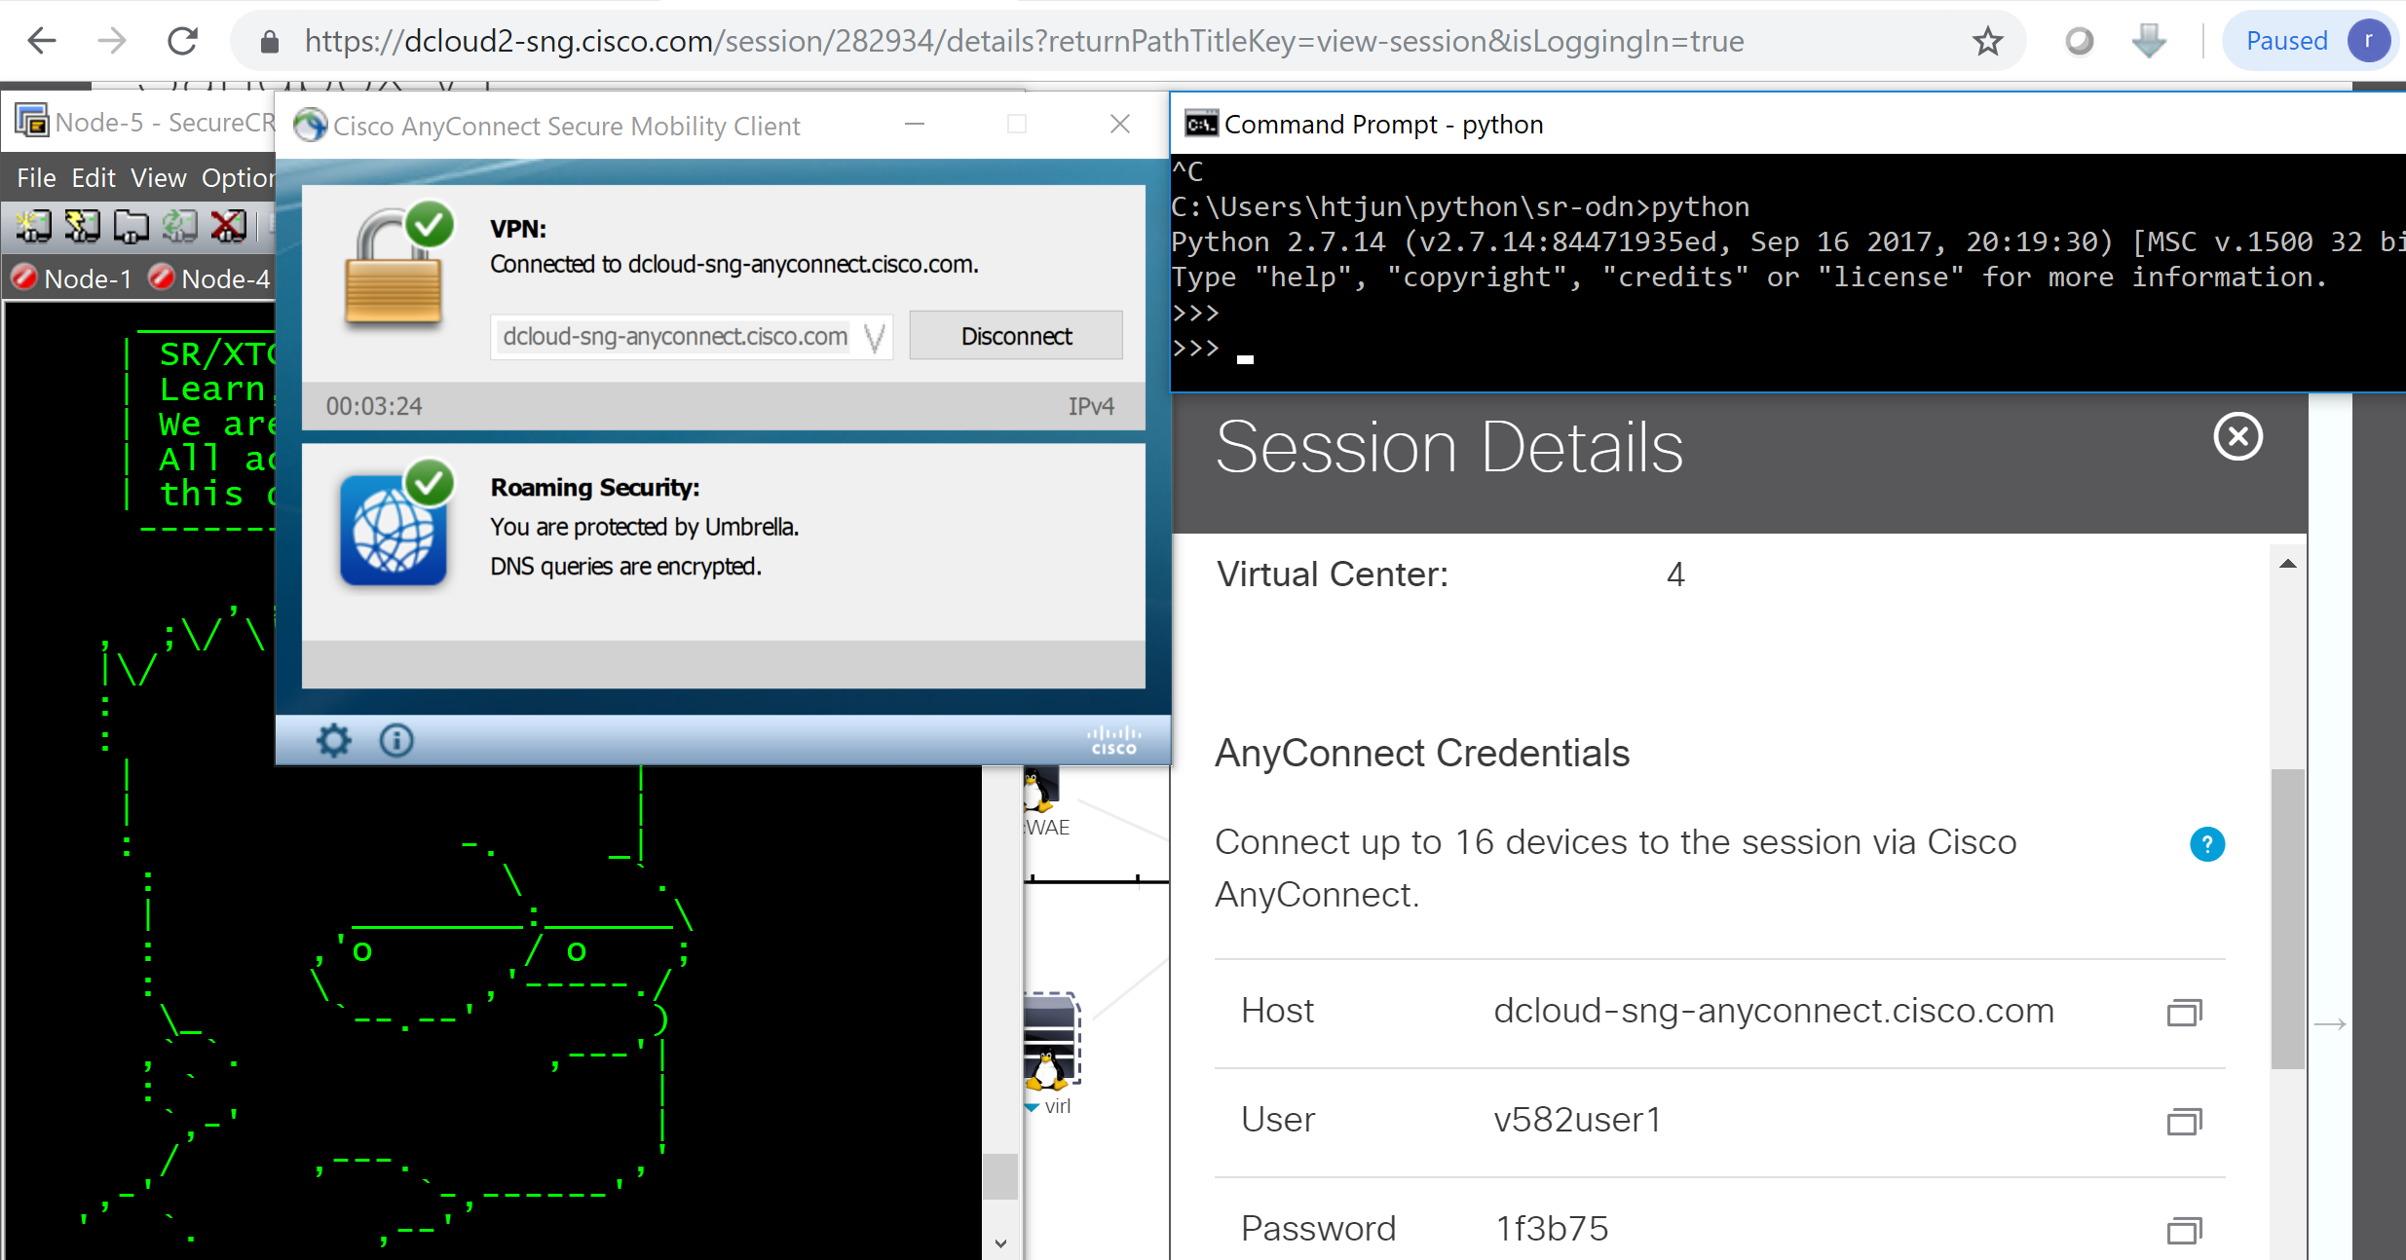

Slide 4
0. Understanding SR Lab Topology Segment Routing (simplicity) Prefix SID Adjacency SID TI-LFA (auto FRR – protection) SR ECMP (auto load balance)

Slide 5
Lab Topology
5
1
2
8
3
6
7
4

Slide 6
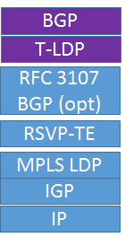

Topology
Lo0 IP = 1.1.1.Z (Z = Local Router Number )
Inft IP = 10.X.Y.Z (X = 1st Router Number )
(Y = 2nd Router Number )
Segment Routing MPLS Network
SR Global Block : 16.000 – 80.000 (Prefix SID)
> 80.000 (Adj SID)
BGP VPN
201
251
202
252
XTC1
RR1
XTC2
RR2
0/0
0/0
0/0
0/0
10.1.201.201
10.1.201.251
10.1.202.202
10.1.202.252
ISIS + SR
+
10.1.201.1
10.1.202.1
0/5
0/6
XTC
1.1.1.5
0/0
10.1.5.5
10.1.5.Z
10.1.5.1
0/0
0/1
0/0
5
IGP = 100
1
IGP = 100
2
0/2
0/3
0/4
0/2
0/1
0/2
0/1
0/0
0/2
0/0
0/2
8
3
0/1
0/3
0/1
0/3
0/0
0/2
0/1
0/2
0/3
0/4
0/2
IGP = 100
IGP = 100
6
0/1
0/0
7
0/1
0/0
4

Slide 7
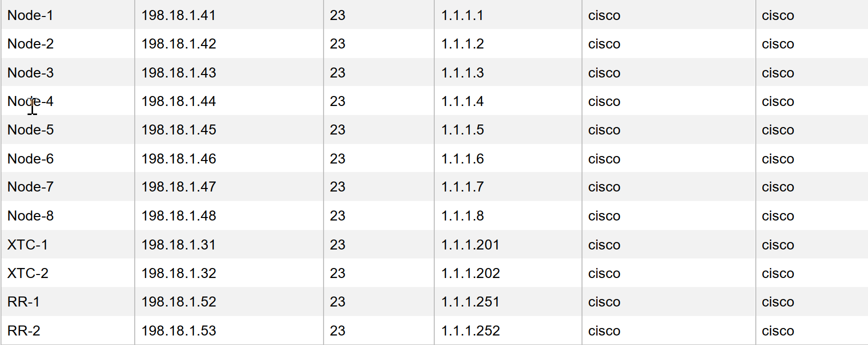
Lab Access Credential

Slide 8
SR Predefined Configuration
5
1
2
8
3
6
7
4
Show run router isis
Show run router bgp
Show run segment-routing
Show run mpls ldp
Show run mpls traffic-engineering
Show mpls ldp neighbor
Show mpls forwarding
Show isis adjacency detail
Show route
Show route 1.1.1.1 detail
Show cef 1.1.1.1/32 detail
Show mpls forwarding labels 16001 detail

Slide 9
SR ECMP
5
1
2
8
3
6
7
4
@Node 5
Ping 1.1.1.4
Ping sr-mpls 1.1.1.4/32
Trace 1.1.1.4
Trace sr-mpls 1.1.1.4/32
trace sr-mpls multipath 1.1.1.4/32 verbose
Stop Traffic Generator @ dcloud control page
Stop > disable traffic
@Node 8
Monitor interface g0/0/0/0 g0/0/0/2 g0/0/0/3
Add 2 telnet Node-8
Trace 1.1.1.4 source 10.5.8.8
Trace 1.1.1.4 source 10.6.8.8
Ping 1.1.1.4 source 10.5.8.8 repeat 100000
Ping 1.1.1.4 source 10.6.8.8 repeat 100000
Show Route
@Node 4
Trace 10.5.8.8
Trace 10.6.8.8
Python node-8-shut-int-g2.py
Python node-8-no-shut-int-g2.py

Slide 10
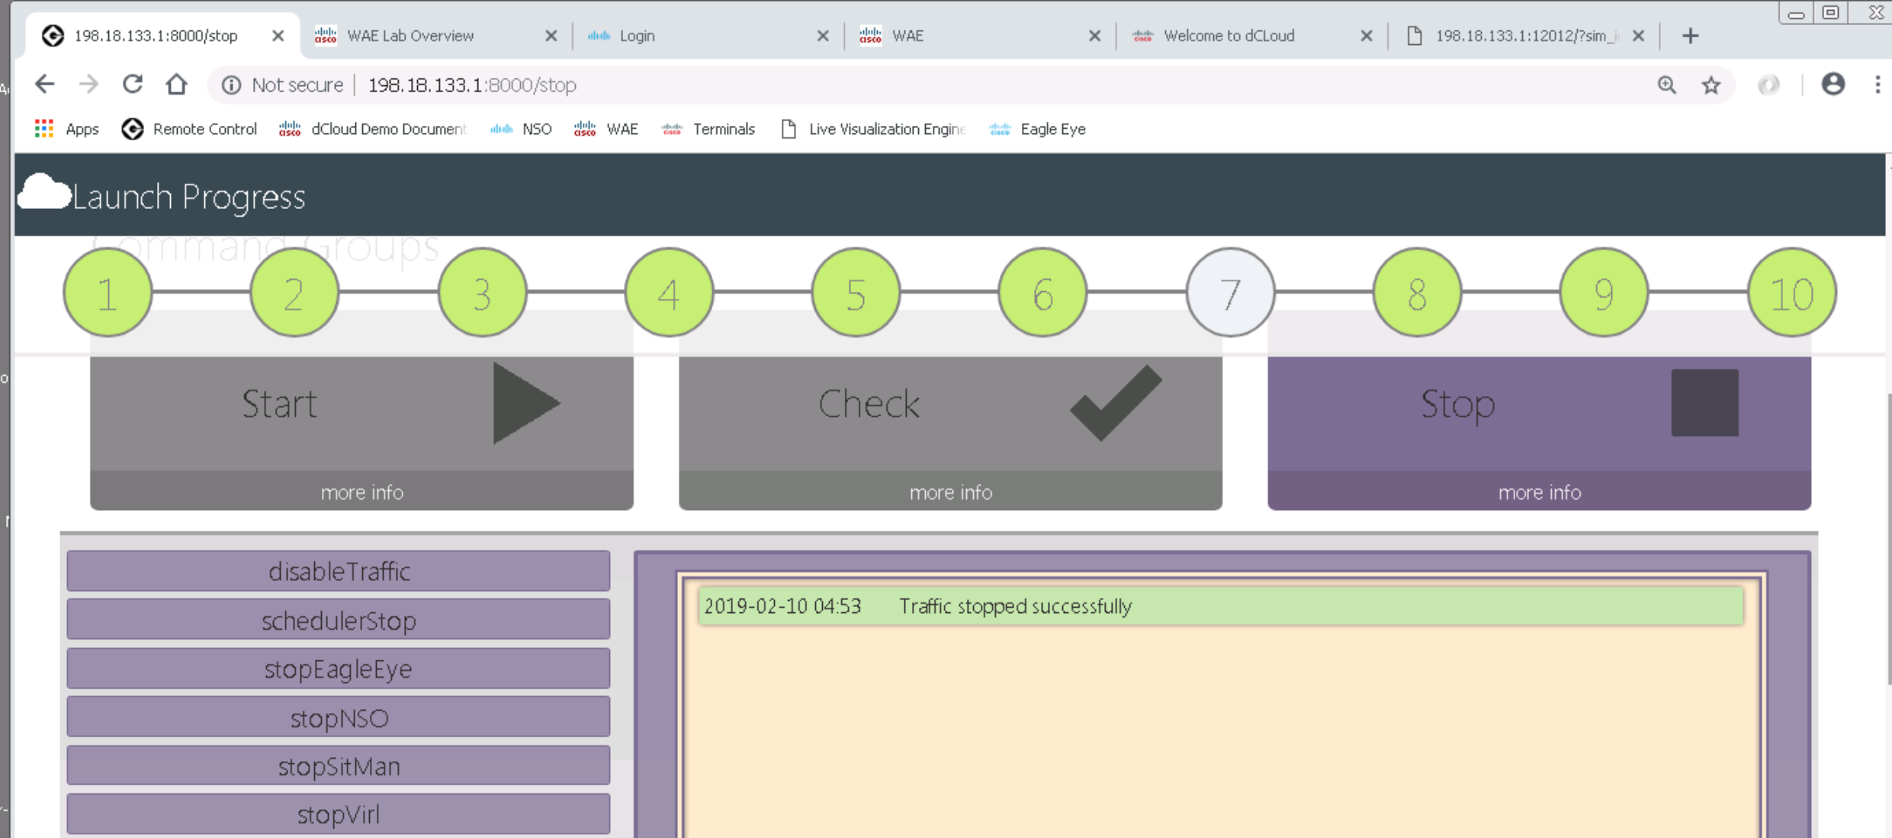

Slide 11
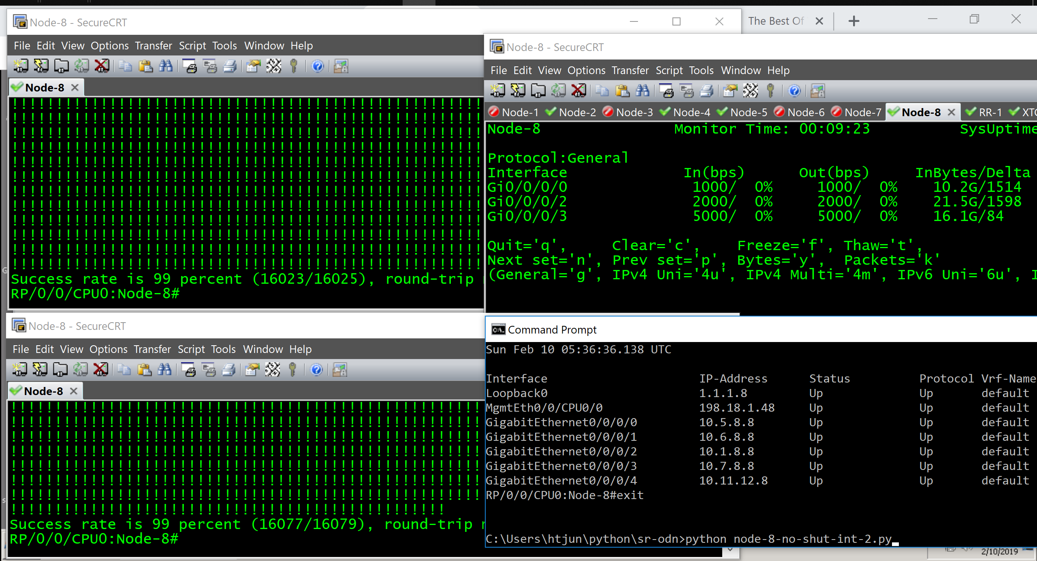

Slide 12
1. Build VPNv4 on SR Lab vrf red vrf blue SR ECMP

Slide 13
VPNv4 Topology
Lo0 IP = 1.1.1.Z (Z = Local Router Number )
Inft IP = 10.X.Y.Z (X = 1st Router Number )
(Y = 2nd Router Number )
Segment Routing MPLS Network
SR Global Block : 16.000 – 80.000 (Prefix SID)
> 80.000 (Adj SID)
201
251
202
252
XTC1
RR1
XTC2
RR2
0/0
0/0
0/0
0/0
10.1.201.201
10.1.201.251
10.1.202.202
10.1.202.252
5.5.5.5
50.50.50.50
55.55.55.55
0/5
0/6
1.1.1.5
0/0
10.1.5.5
10.1.5.Z
10.1.5.1
0/0
0/1
0/0
15.15.15.15
150.150.150.150
155.155.155.155
5
IGP = 100
1
IGP = 100
2
0/2
0/3
0/4
0/2
0/1
0/2
0/1
0/0
0/2
0/0
0/2
8
3
0/1
0/3
0/1
0/3
0/0
0/2
0/1
4.4.4.4
40.40.40.40
44.44.44.44
0/2
0/3
0/4
0/2
IGP = 100
IGP = 100
6
0/1
0/0
7
0/1
0/0
4
14.14.14.14
140.140.140.140
144.144.144.144

Slide 14
VPNv4 vrf red blue
5
1
2
8
3
6
7
4
Python node-4-vrf-red-blue.py
Python node-5-vrf-red-blue.py
@Node4 & 5
Show config commit change last 1
@Node5
Show bgp vpnv4 uni sum
Show bgp vpnv4 uni
Show route vrf red
Show mpls forward
Show cef vrf red 4.4.4.4
Trace vrf red 4.4.4.4 source 5.5.5.5
Trace vrf red 4.4.4.4 source 50.50.50.50

Slide 15
2. Build SR Domain + LDP-RSVP Domain Use Case P - PE

Slide 16



SR + LDP_RSVP Topology
SR Domain
LDP_RSVP Domain
0/1
5
1
2
0/1
Biz CPE
8
3
0/0
0/1
6
7
4
Biz CPE

Slide 17
Enable LDP_RSVP @1,2,3,4,7 Disable SR @2,3,4
5
1
2
8
3
@Node5
Show route
Ping sr-mpls 1.1.1.1/32
Ping sr-mpls 1.1.1.4/32
Show mpls forwarding
Show cef 1.1.1.1/32
Show cef 1.1.1.4/32
Ping vrf red 4.4.4.4
Show cef vrf red 4.4.4.4
@Node4
Show route
Ping mpls ipv4 1.1.1.7/32
Ping mpls ipv4 1.1.1.5/32 fec generic
Show mpls forwarding
Show cef 1.1.1.5/32
Show mpls for | in (label imposed)
Ping vrf red 5.5.5.5
Show cef vrf red 5.5.5.5
6
7
4
Python node-1 intf-rsvp-ldp
Python node-2 intf-rsvp-ldp
Python node-3 intf-rsvp-ldp
Python node-4 intf-rsvp-ldp
Python node-7 intf-rsvp-ldp
Python node-2 no-migrate-to-sr
Python node-3 no-migrate-to-sr
Python node-4 no-migrate-to-sr
@Node 2,3,4
Show mpls forwarding (complexity)
Dependency igp-ldp sync
sh mpls for | util wc lines
sh route | util wc lines

Slide 18
3. Build SR Mapping Server Interworking SR + LDP

Slide 19
SR Mapping Lab
SR Mapping Server
SR Domain
LDP Domain
0/1
5
1
2
0/1
Biz CPE
8
3
0/0
0/1
6
7
4
SR Mapping Server
Biz CPE

Slide 20
Enable SR Mapping Server @1,8
5
1
2
8
3
6
7
4
Python node-1 sr-mapping
Python node-8 sr-mapping
@Node5
Show route
Ping sr-mpls 1.1.1.1/32
Ping sr-mpls 1.1.1.4/32
Show mpls forwarding
Show cef 1.1.1.4/32
@Node4
Show route
Ping mpls ipv4 1.1.1.7/32
Ping mpls ipv4 1.1.1.5/32
Show mpls forwarding
Show cef 1.1.1.5/32
@Node1, 8
Show segment mapping prefix ipv4
Show segment mapping prefix ipv4 detail
@Node NON-SR
Show isis/ospf segment prefix active-policy detail
Show isis/ospf segment prefix backup-policy detail
@Node5 – SR ECMP + LDP + SR Mapping Server
trace vrf red 4.4.4.4 source 5.5.5.5
Trace vrf red 4.4.4.4 source 50.50.50.50

Slide 21
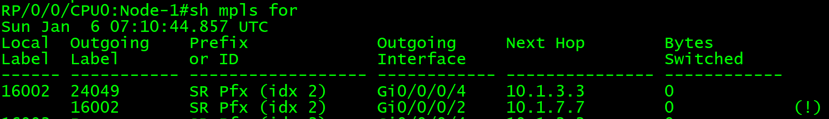
Label Swap from Node 5 to Node 2
0/1
5
1
2
0/1
Biz CPE
8
3
0/0
0/1
6
7
4
Biz CPE

Slide 22
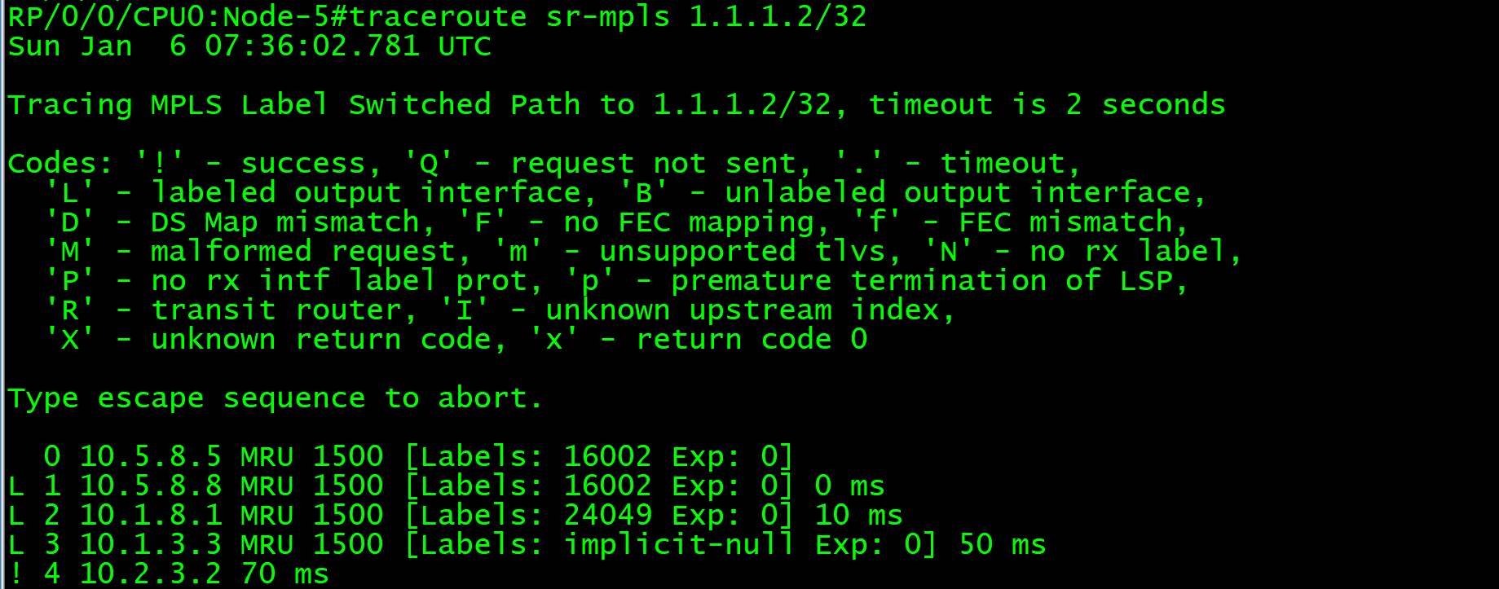
Traceroute Label Swap
from Node 5 to Node 2
0/1
5
1
2
0/1
Biz CPE
8
3
0/0
0/1
6
7
4
Biz CPE

Slide 23
4. Interworking SR + RSVP_TE Interworking SRTE + RSVP_TE

Slide 24
SR ECMP + RSVP_TE Lab
Int tunnel-te4
1-2-4
5.5.5.5
50.50.50.50
55.55.55.55
0/1
5
1
2
0/1
Biz CPE
8
3
4.4.4.4
40.40.40.40
44.44.44.44
0/0
0/1
6
7
4
Biz CPE
Int tunnel-te4
7-4

Slide 25
Setup SR ECMP + RSVP_TE
5
1
2
8
3
6
7
4
Python node-1 rsvpte-4
Python node-7 rsvpte-4
@Node5
Trace vrf red 4.4.4.4 source 5.5.5.5 (before)
Trace vrf red 4.4.4.4 source 5.5.5.5 (after)
@Node1
Show ip int brief
Show mpls traffic tunnel
@Node5
Trace vrf red 4.4.4.4 source 50.50.50.50 (before)
Trace vrf red 4.4.4.4 source 50.50.50.50 (after)
@Node7
Show ip int brief
Show mpls traffic tunnel

Slide 26
RSVP_TE + SR ECMP Lab
5.5.5.5
50.50.50.50
55.55.55.55
0/1
5
1
2
0/1
Biz CPE
Int tunnel-te4215
4-2-1-5
8
3
4.4.4.4
40.40.40.40
44.44.44.44
0/0
0/1
6
7
4
Biz CPE
Int tunnel-te475
4-7-5

Slide 27
Setup RSVP_TE + SR ECMP
5
1
2
8
3
6
7
4
Python node-4 rsvpte-4215
Python node-4 rsvpte-475
@Node4
Trace vrf red 5.5.5.5 source 4.4.4.4 (before)
Trace vrf red 5.5.5.5 source 4.4.4.4 (after)
@Node1
Show ip int brief
Show mpls traffic tunnel
@Node4
Trace vrf red 50.50.50.50 source 4.4.4.4 (before)
Trace vrf red 50.50.50.50 source 4.4.4.4 (after)
@Node7
Show ip int brief
Show mpls traffic tunnel

Slide 28
SR Policy + RSVP_TE Lab
Int tunnel-te4
explicit 1-2-4
Bsid 124
sr policy c4 node4
explicit 5-1
5.5.5.5
50.50.50.50
55.55.55.55
15.15.15.15
150.150.150.150
155.155.155.155
0/1
5
1
2
0/1
Biz CPE
8
3
4.4.4.4
40.40.40.40
44.44.44.44
0/0
0/1
6
7
4
14.14.14.14
140.140.140.140
144.144.144.144
sr policy c14 node4
explicit 5-6-7
Biz CPE
Int tunnel-te4
explicit 7-4
Bsid 74

Slide 29
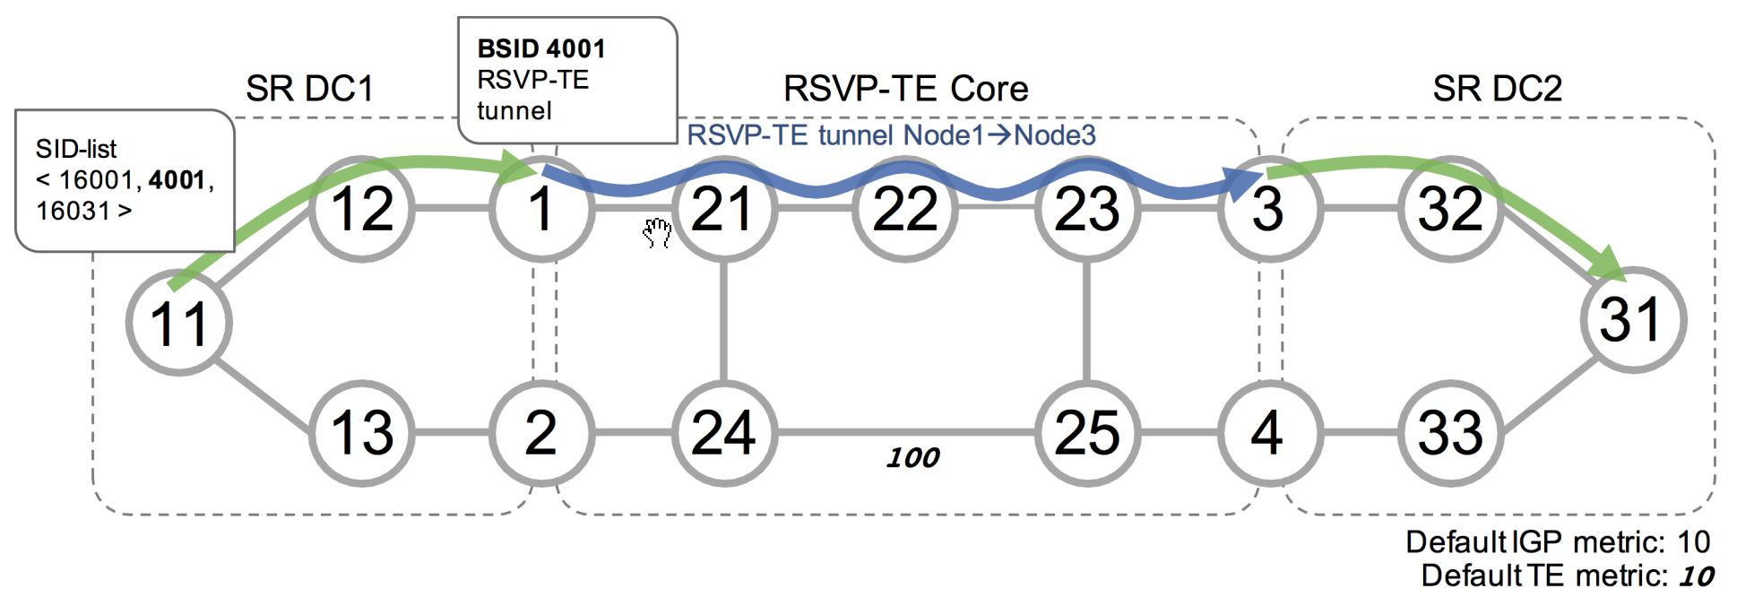

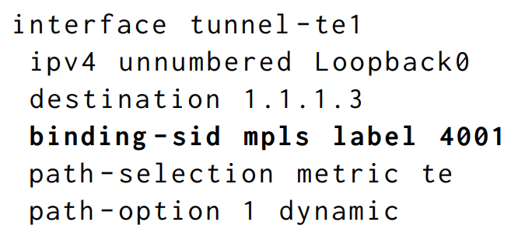
Binding SID for RSVP-TE Tunnel

Slide 30
Setup SR Policy + RSVP_TE
5
1
2
8
3
6
7
4
Python node-5 srte-c4-node1
@Node5
Trace vrf red 4.4.4.4 (before)
Ping vrf red 4.4.4.4 repeat 100000
Trace vrf red 4.4.4.4 (after)
Show segment traffic policy
Python node-5-srte-c14-node7
@Node5
Trace vrf blue 14.14.14.14 (before)
Ping vrf red 14.14.14.14 repeat 100000
Trace vrf blue 14.14.14.14 (after)
Show segment traffic policy

Slide 31
5. LDP to SR Migration

Slide 32
LDP to SR Migration
5
1
2
8
3
6
7
4
Python node-1 no-rsvpte-4
Python node-7 no-rsvpte-4
Python node-4 no-rsvpte-4215
Python node-4 no-rsvpte-475
Python node-5 no-srte-c4-to-node1
Python node-5 no-srte-c14-to-node7
Before @ Node 2,3,4
Show mpls forwarding | util wc lines
Python node-1 migrate-to-sr
Python node-2 migrate-to-sr
Python node-3 migrate-to-sr
Python node-4 migrate-to-sr
Python node-7 migrate-to-sr
Python node-1 no-sr-mapping
Python node-8 no-sr-mapping
@Node5
Ping sr-mpls 1.1.1.4/32
Trace sr-mpls multipath 1.1.1.4/32 verbose
Trace vrf red 4.4.4.4
Trace vrf blue 14.14.14.14
@Node2, 3, 4
Show mpls forwarding (simplicity and reduce label)
Show mpls for | util wc lines

Slide 33
6. Microloop Avoidance Segment Routing

Slide 34
Enable Microloop Avoidance
5
1
2
8
3
6
7
4
Python node-1 microloop
Python node-2 microloop
Python node-3 microloop
Python node-4 microloop
Python node-5 microloop
Python node-6 microloop
Python node-7 microloop
Python node-8 microloop
@Node ANY
Show run router isis

Slide 35
7. VPNv4 SR ECMP + Link Failure

Slide 36
VPNv4 SR ECMP + Normal Link
5.5.5.5
50.50.50.50
55.55.55.55
1.1.1.5
0/0
10.1.5.5
10.1.5.Z
10.1.5.1
0/0
0/1
0/0
5
IGP = 100
1
IGP = 100
2
0/2
0/3
0/4
0/2
0/1
0/2
0/1
0/0
0/2
0/0
0/2
8
3
0/1
0/3
0/1
0/3
0/0
0/2
0/1
4.4.4.4
40.40.40.40
44.44.44.44
0/2
0/3
0/4
0/2
IGP = 100
IGP = 100
6
0/1
0/0
7
0/1
0/0
4

Slide 37
VPNv4 SR ECMP + Link Failure
5.5.5.5
50.50.50.50
55.55.55.55
1.1.1.5
0/0
10.1.5.5
10.1.5.Z
10.1.5.1
0/0
0/1
0/0
15.15.15.15
150.150.150.150
155.155.155.155
5
IGP = 100
1
IGP = 100
2
0/2
0/3
0/4
0/2
0/1
0/2
0/1
0/0
0/2
0/0
0/2
8
3
0/1
0/3
0/1
0/3
0/0
0/2
0/1
4.4.4.4
40.40.40.40
44.44.44.44
0/2
0/3
0/4
0/2
IGP = 100
IGP = 100
6
0/1
0/0
7
0/1
0/0
4
14.14.14.14
140.140.140.140
144.144.144.144

Slide 38
VPNv4 SR ECMP + Link Failure
5
1
2
8
3
6
7
4
@Node5
Trace vrf red 4.4.4.4 source 5.5.5.5
Trace vrf red 4.4.4.4 source 50.50.50.50
Trace before link failure
Trace after link failure
@Node8
Monitor interface g0/0/0/0 g0/0/0/1 g0/0/0/2 g0/0/0/3
Add 2 telnet Node5
Python node-5-shut-int-2
Python node-5-no-shut-int-2
Ping vrf red 4.4.4.4 source 5.5.5.5 repeat 100000
Ping vrf red 4.4.4.4 source 50.50.50.50 repeat 100000

Slide 39
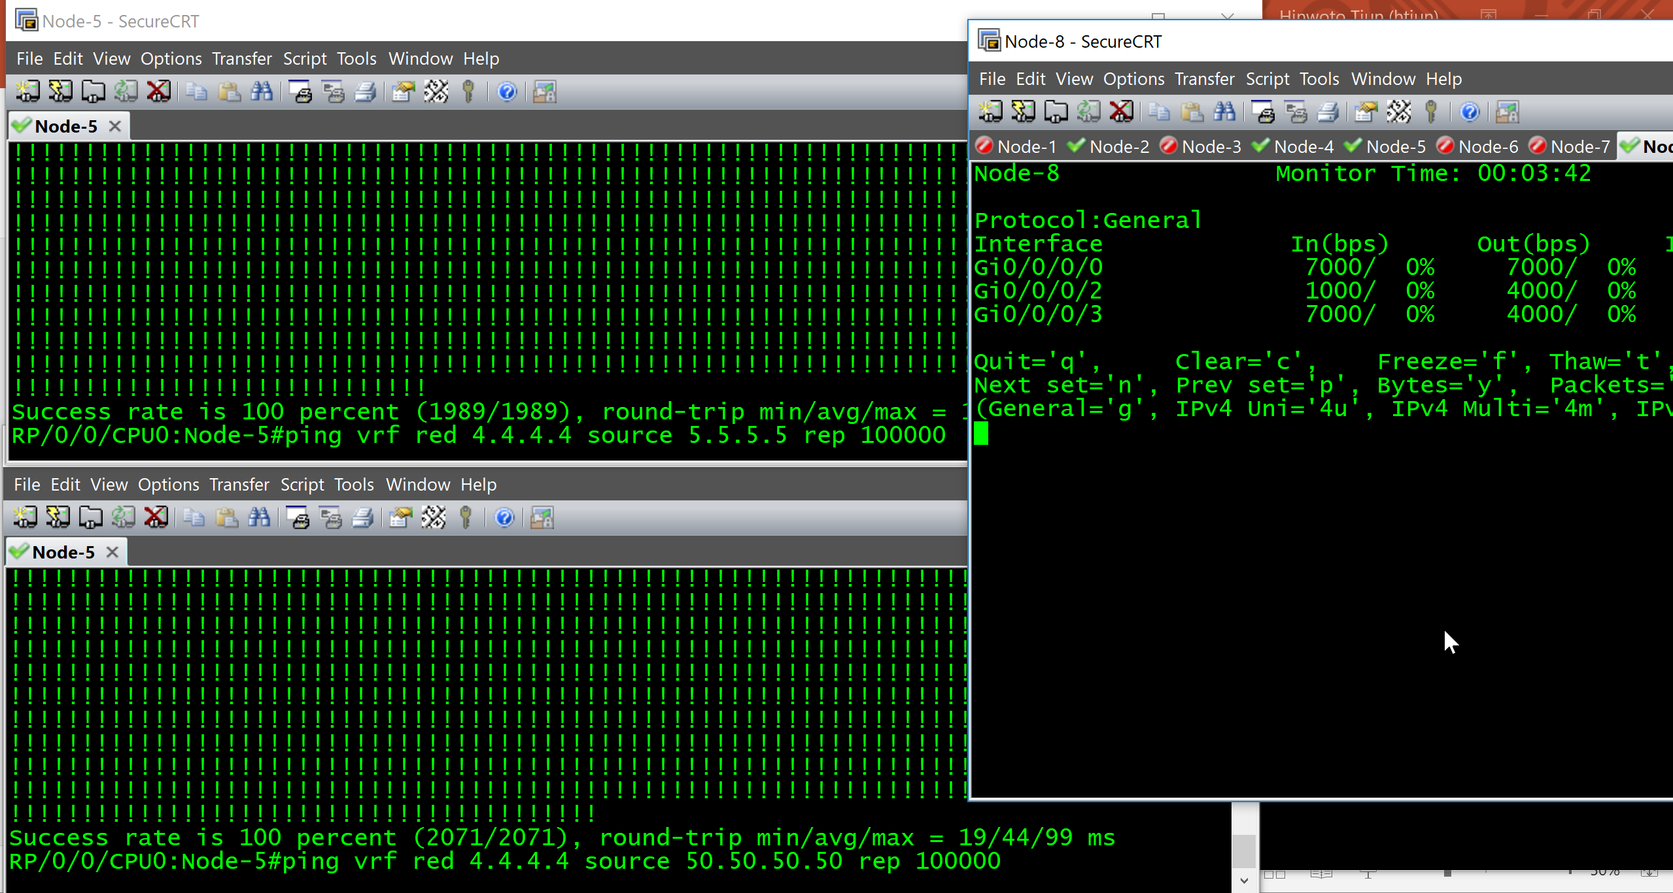

Slide 40
8. SR Policy VPNv4 Automated Steering (dynamic te metric, link failure, delay increase)

Slide 41
VPNv4 SR Policy Automated Steering color + end-point
4.4.4.4
40.40.40.40
44.44.44.44
251
RR1
C4 : 4.4.4.4
C4 : 40.40.40.40
C44 : 44.44.44.44
1.1.1.5
0/0
10.1.5.5
10.1.5.Z
10.1.5.1
0/0
0/1
0/0
5
IGP = 100
1
IGP = 100
2
0/2
0/3
0/4
0/2
0/1
0/2
0/1
0/0
0/2
0/0
0/2
8
3
0/1
0/3
0/1
0/3
0/0
0/2
0/1
4.4.4.4
40.40.40.40
44.44.44.44
0/2
0/3
0/4
0/2
IGP = 100
IGP = 100
6
0/1
0/0
7
0/1
0/0
4

Slide 42
VPNv4 SR Policy Automated Steering dynamic te metric
sr policy c4 node4
Dynamic Metric : te
C4 : 4.4.4.4
C4 : 40.40.40.40
C44 : 44.44.44.44
1.1.1.5
0/0
10.1.5.5
10.1.5.Z
10.1.5.1
0/0
0/1
0/0
5
IGP = 100
1
IGP = 100
2
0/2
0/3
0/4
0/2
0/1
0/2
0/1
0/0
0/2
0/0
0/2
8
3
0/1
0/3
0/1
0/3
0/0
0/2
0/1
4.4.4.4
40.40.40.40
44.44.44.44
0/2
0/3
0/4
0/2
IGP = 100
IGP = 100
6
0/1
0/0
7
0/1
0/0
4

Slide 43
VPNv4 SR Policy Automated Steering link failure
sr policy c4 node4
Dynamic Metric : te
C4 : 4.4.4.4
C4 : 40.40.40.40
C44 : 44.44.44.44
1.1.1.5
0/0
10.1.5.5
10.1.5.Z
10.1.5.1
0/0
0/1
0/0
5
IGP = 100
1
IGP = 100
2
0/2
0/3
0/4
0/2
0/1
0/2
0/1
0/0
0/2
0/0
0/2
8
3
0/1
0/3
0/1
0/3
0/0
0/2
0/1
4.4.4.4
40.40.40.40
44.44.44.44
0/2
0/3
0/4
0/2
IGP = 100
IGP = 100
6
0/1
0/0
7
0/1
0/0
4

Slide 44

VPNv4 SR Policy Automated Steering delay increase
sr policy c4 node4
Dynamic Metric : te
C4 : 4.4.4.4
C4 : 40.40.40.40
C44 : 44.44.44.44
1.1.1.5
0/0
10.1.5.5
10.1.5.Z
10.1.5.1
0/0
0/1
0/0
5
IGP = 100
1
IGP = 100
2
0/2
0/3
0/4
0/2
0/1
0/2
0/1
0/0
0/2
0/0
0/2
8
3
0/1
0/3
0/1
0/3
0/0
0/2
0/1
4.4.4.4
40.40.40.40
44.44.44.44
0/2
0/3
0/4
0/2
IGP = 100
IGP = 100
6
0/1
0/0
7
0/1
0/0
4

Slide 45
VPNv4 SR Policy Automated Steering
5
1
2
8
3
6
7
4
Python node-5 srte-to-node-4 --> dynamic te color:4
@Node5
traceroute vrf red 4.4.4.4 source 5.5.5.5 – via te
traceroute vrf red 40.40.40.40 source 5.5.5.5 - via te
traceroute vrf red 44.44.44.44 source 5.5.5.5 - via igp
Python node-5 shut-int-0 --> link failure
Python node-5 delay-30-int-01 --> delay increase/worse
Python node-5 no-shut-int-0 --> link UP
Python node-5 no-delay-30-int-01 --> delay restore
@Node5
Show segment traffic policy
Show route vrf red
Show bgp vpnv4 uni vrf red
Show cef vrf red 4.4.4.4
Show cef vrf red 44.44.44.44
Show mpls forwarding
Ping vrf red 4.4.4.4 repeat 100000

Slide 46
9. SR Policy VPNv4 Automated Steering (constraint affinity)

Slide 47
VPNv4 SR Policy Automated Steering exclude green
sr policy c4 node4
Dynamic Metric : te
C4 : 4.4.4.4
C4 : 40.40.40.40
C44 : 44.44.44.44
1.1.1.5
0/0
10.1.5.5
10.1.5.Z
10.1.5.1
0/0
0/1
0/0
5
IGP = 100
1
IGP = 100
2
0/2
green
0/3
0/4
0/2
0/1
0/2
0/1
0/0
0/2
0/0
0/2
8
3
0/1
0/3
0/1
0/3
0/0
0/2
0/1
4.4.4.4
40.40.40.40
44.44.44.44
0/2
0/3
0/4
0/2
IGP = 100
IGP = 100
6
0/1
0/0
7
0/1
0/0
4

Slide 48
VPNv4 SR Policy Automated Steering - Affinity
5
1
2
8
3
6
7
4
Python node-5 exclude-green --> exclude green g0/0/0/0
@Node5
traceroute vrf red 4.4.4.4 source 5.5.5.5 – via te
traceroute vrf red 40.40.40.40 source 5.5.5.5 - via te
traceroute vrf red 44.44.44.44 source 5.5.5.5 - via igp
Python node-5 no-exclude-green --> normal link
@Node5
Show segment traffic policy
Show route vrf red
Show bgp vpnv4 uni vrf red
Show cef vrf red 4.4.4.4
Show cef vrf red 44.44.44.44
Show mpls forwarding

Slide 49
10. SR Policy VPNv4 Automated Steering (weighted ecmp – unequal load balance)

Slide 50
VPNv4 SR Policy Automated Steering wecmp – unequal load balance
sr policy c4 node4
Candidate path
Segment 4-up
C4 : 4.4.4.4
C4 : 40.40.40.40
C44 : 44.44.44.44
1.1.1.5
0/0
10.1.5.5
10.1.5.Z
10.1.5.1
0/0
0/1
0/0
5
IGP = 100
1
IGP = 100
2
0/2
0/3
0/4
0/2
0/1
0/2
0/1
0/0
0/2
0/0
0/2
8
3
0/1
0/3
0/1
0/3
0/0
0/2
0/1
4.4.4.4
40.40.40.40
44.44.44.44
0/2
0/3
0/4
0/2
IGP = 100
IGP = 100
6
0/1
0/0
7
0/1
0/0
4
sr policy c4 node4
Candidate path
Segment 4-down

Slide 51
VPNv4 SR Policy Automated Steering - wecmp
5
1
2
8
3
6
7
4
Python node-5 no-srte-to-node-4 -> clear old srte
Python node-5 wecmp-up-node-4 -> up 2 : 1
Python node-5 wecmp-down-node-4 -> down 2 : 1
Python node-5 no-wecmp-node-4
@Node5
monitor rate
Traceroute
vrf red 4.4.4.4 source 5.5.5.5
vrf red 4.4.4.4 source 50.50.50.50
vrf red 4.4.4.4 source 55.55.55.55
vrf red 40.40.40.40 source 5.5.5.5
vrf red 40.40.40.40 source 50.50.50.50
vrf red 40.40.40.40 source 55.55.55.55
Simple
Only 1 SR Policy – not required many intf te-tun
Good scalability

Slide 52
11. Use Case Seamless MPLS Multi-IGP Domain - OSPF

Slide 53
Multi-IGP Domain - OSPF
Low Delay
Transport Link
High Delay Transport Link
0/1
5
1
2
0/1
Biz CPE
8
3
0/0
0/1
6
7
4
ospf area 0
ospf area 0
Biz CPE

Slide 54
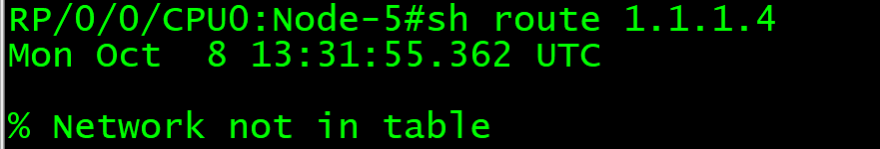
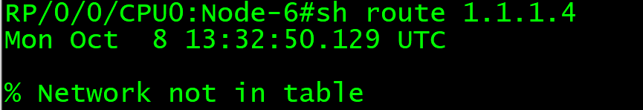
Segment Routing + Seamless MPLS Architecture
for Simple, Flexible and Scalable Network
Multiple IGP domain with BGP LU or SDN Controller
Large Scale and Flexible Network (up to 100.000)
More Stable Network – Isolated Network Change Impact
0/1
5
Smaller Route Table
R1 and R7 as Gateway to Other IGP Domain
Learn from SDN Controller
Route to other IGP Domain Router
1
2
0/1
Biz CPE
8
3
0/0
0/1
6
ospf area 0
SR Network
7
ospf area 0
SR Network
4
Biz CPE

Slide 55
Multi-IGP Domain OSPF
5
1
2
8
3
6
7
4
Python node-1 multi-domain
Python node-2 multi-domain
Python node-3 multi-domain
Python node-4 multi-domain
Python node-5 multi-domain
Python node-6 multi-domain
Python node-7 multi-domain
Python node-8 multi-domain
@Node5, 1, 7, 4
Show run router ospf
Traceroute
vrf red 4.4.4.4 source 5.5.5.5
vrf red 4.4.4.4 source 50.50.50.50
vrf red 4.4.4.4 source 55.55.55.55
vrf red 40.40.40.40 source 5.5.5.5
vrf red 40.40.40.40 source 50.50.50.50
vrf red 40.40.40.40 source 55.55.55.55

Slide 56
12. Use Case Seamless MPLS Multi-IGP Domain – OSPF (SR + BGP LU + BGP Prefix SID)

Slide 57
Multi-IGP Domain – OSPF
(SR + BGP LU + BGP Prefix SID)
Bgp LU
0/1
5
1
2
0/1
Biz CPE
8
3
0/0
0/1
6
7
4
ospf area 0
ospf area 0
Biz CPE

Slide 58
Multi-IGP Domain OSPF (SR + BGP LU + BGP Prefix SID)
5
1
2
8
3
6
7
4
Python node-1 bgp-lu-prefix-sid
Python node-4 bgp-lu-prefix-sid
Python node-5 bgp-lu-prefix-sid
@Node5
Show route | in 1.1.1.4
Show mpls forward | in 16004
Show bgp ipv4 label
Show bgp ipv4 label sum
Show run router bgp
@Node5, 1, 4
Show run router ospf
Show bgp vpnv4 uni
Show cef vrf red 4.4.4.4
Show bgp ipv4 label sum
Show bgp ipv4 label
Traceroute
vrf red 4.4.4.4 source 5.5.5.5
vrf red 4.4.4.4 source 50.50.50.50
vrf red 4.4.4.4 source 55.55.55.55
vrf red 40.40.40.40 source 5.5.5.5
vrf red 40.40.40.40 source 50.50.50.50
vrf red 40.40.40.40 source 55.55.55.55

Slide 59
13. Use Case Seamless MPLS Multi-IGP Domain – OSPF (SR Policy Explicit + WITH BGP LU)

Slide 60
Multi-IGP Domain – OSPF
(SR Policy Explicit + WITH BGP LU)
sr policy c4 node4
Explicit 5-1-4
Bgp LU
0/1
5
1
2
0/1
Biz CPE
8
3
0/0
0/1
6
7
4
ospf area 0
ospf area 0
Biz CPE
sr policy c4 node4
Explicit 4-7-5

Slide 61
Multi-IGP Domain OSPF (SR Policy Explicit + WITH BGP LU)
5
1
2
8
3
6
7
4
Python node-4 srte-red-explicit-to-node-5
Python node-5 srte-red-explicit-to-node-4
Trace before python
Trace after python
(initial with prefix sid, then
Change to adjacency label)
@Node5, 1, 4
Show run router ospf
Show bgp vpnv4 uni
Show cef vrf red 4.4.4.4
Traceroute
vrf red 4.4.4.4 source 5.5.5.5
vrf red 4.4.4.4 source 50.50.50.50
vrf red 4.4.4.4 source 55.55.55.55
vrf red 40.40.40.40 source 5.5.5.5
vrf red 40.40.40.40 source 50.50.50.50
vrf red 40.40.40.40 source 55.55.55.55

Slide 62
14. Use Case Seamless MPLS Multi-IGP Domain – OSPF (SR Policy Explicit + WITHOUT BGP LU)

Slide 63
Multi-IGP Domain – OSPF
(SR Policy Explicit + WITHOUT BGP LU)
sr policy c4 node4
Explicit 5-1-4
Bgp LU DELETION
0/1
5
1
2
0/1
Biz CPE
8
3
0/0
0/1
6
7
4
ospf area 0
ospf area 0
Biz CPE
sr policy c4 node4
Explicit 4-7-5

Slide 64
Multi-IGP Domain OSPF (SR Policy Explicit + WITHOUT BGP LU)
5
1
2
8
3
6
7
4
Trace before python
Trace after python
@Node5
Trace vrf red 4.4.4.4
Ping vrf red 4.4.4.4 repeat 100000
Python node-1 no-bgp-lu-prefix-sid
Python node-4 no-bgp-lu-prefix-sid
Python node-5 no-bgp-lu-prefix-sid
Trace before python
Trace after python
@Node5
Trace vrf red 4.4.4.4
Ping vrf red 4.4.4.4 repeat 100000
@Node5, 1, 4
Show run router ospf
Show bgp vpnv4 uni
Show cef vrf red 4.4.4.4
Traceroute
vrf red 4.4.4.4 source 5.5.5.5
vrf red 4.4.4.4 source 50.50.50.50
vrf red 4.4.4.4 source 55.55.55.55
vrf red 40.40.40.40 source 5.5.5.5
vrf red 40.40.40.40 source 50.50.50.50
vrf red 40.40.40.40 source 55.55.55.55

Slide 65
15. Use Case Seamless MPLS Multi-IGP Domain – OSPF (SR Policy Explicit + Binding SID)

Slide 66
Multi-IGP Domain – OSPF
(SR Policy Explicit + Binding SID)
Vrf red
sr policy c4 node4
Explicit 5-1-4
Bsid 90001
1-7-3-2-4
0/1
5
1
2
0/1
Biz CPE
8
3
0/0
0/1
6
7
4
ospf area 0
ospf area 0
Biz CPE

Slide 67
Multi-IGP Domain OSPF (SR Policy Explicit + Binding SID)
5
1
2
8
3
6
7
4
Clear previous SR-Policy
Python node-5 no-srte-red-explicit-to-node-4
Python node-5 srte-red-bsid-90001
Python node-1 srte-bsid-90001-to-node-4
Trace before python
Trace after python
@Node5, 4
Show run router ospf
Show bgp vpnv4 uni
Show cef vrf red 4.4.4.4
Traceroute
vrf red 4.4.4.4 source 5.5.5.5
vrf blue 14.14.14.14 source 15.15.15.15

Slide 68
Multi-IGP Domain – OSPF
(SR Policy Explicit + Binding SID)
Vrf red
sr policy c4 node4
Explicit 5-1-4
Bsid 90001
1-7-3-2-4
0/1
5
1
2
0/1
Biz CPE
8
3
0/0
0/1
6
7
4
ospf area 0
ospf area 0
Biz CPE
Vrf blue
sr policy c4 node4
Explicit 5-6-8-1-4

Slide 69
Multi-IGP Domain OSPF (SR Policy Explicit + Binding SID)
5
1
2
8
3
6
7
4
Python node-5 no-srte-red-explicit-to-node-4
Python node-5 srte-red-bsid-90001
Python node-5 srte-blue-bsid-90001
Python node-1 srte-bsid-90001-to-node-4
Trace before python
Trace after python
@Node5, 4
Show run router ospf
Show bgp vpnv4 uni
Show cef vrf red 4.4.4.4
Traceroute
vrf red 4.4.4.4 source 5.5.5.5
vrf blue 14.14.14.14 source 15.15.15.15

Slide 70
Multi-IGP Domain – OSPF
(SR Policy Explicit + Binding SID)
0/1
5
1
2
0/1
Biz CPE
8
3
0/0
0/1
6
7
4
ospf area 0
ospf area 0
Biz CPE
Vrf blue
sr policy c15 nod
Explicit 4-7-5
Vrf red
sr policy c5 node4
Explicit 4-7-5

Slide 71
Multi-IGP Domain OSPF (SR Policy Explicit + Binding SID)
5
1
2
8
3
6
7
4
Python node-5 no-srte-red-explicit-to-node-4
Python node-5 srte-red-bsid-90001
Python node-5 srte-blue-bsid-90001
Python node-1 srte-bsid-90001-to-node-4
Python node-4 srte-blue-explicit-to-node-5
Python node-4 srte-red-explicit-to-node-5
(because no bgp-lu)
Trace before python
Trace after python
(expect to adjust adjacency labe in SR-Policy)
@Node5, 4
Show run router ospf
Show bgp vpnv4 uni
Show cef vrf red 4.4.4.4
Traceroute
vrf red 4.4.4.4 source 5.5.5.5
vrf blue 14.14.14.14 source 15.15.15.15

Slide 72
Clear SR Policy

Slide 73
Clear SR Policy
5
1
2
8
3
6
7
4
Python node-5 no-srte-red-bsid-90001
Python node-5 no-srte-blue-bsid-90001
Python node-1 no-srte-bsid-90001-to-node-4
Python node-4 no-srte-blue-explicit-to-node-5
Python node-4 no-srte-red-explicit-to-node-5
@Node5, 4
Show segment traffic policy
Trace before python
Trace after python

Slide 74
16. SR ODN On-Demand NextHop + SR PCE

Slide 75
SR ODN + SR PCE
5
1
2
8
3
@Node5
Ping vrf red 4.4.4.4 repeat 100000
Python Node-5 odn-c4
Python Node-4 odn-c5
Python node-5 shut-int-0 --> link failure
Python node-5 delay-30-int-01 --> delay increase/worse
Python node-5 no-delay-30-int-01 --> delay restore
Python node-5 no-shut-int-0 --> link UP
show segment-routing traffic-eng pcc ipv4 peer
Python node-5 no-pcc --> SR PCE Primary down
- SR PCE Backup → ACTIVE
Python node-5 no-pcc2 --> SR PCE Backup down
Why time out ?
Show segment traffic policy
6
7
4
Python node-5 pcc
→ SR PCE Primary Restore UP
Python node-4 shut-int-lo0-lo40
auto-delete SR Policy
@Node5, show segment traffic policy
@SR PCE
Show pce ipv4 cspf source 1.1.1.5 destination 1.1.1.4 metric-type te
@Node5, Traceroute
vrf red 4.4.4.4 source 5.5.5.5
vrf blue 14.14.14.14 source 15.15.15.15
@Node5
Ping vrf red 4.4.4.4 repeat 100000

Slide 76
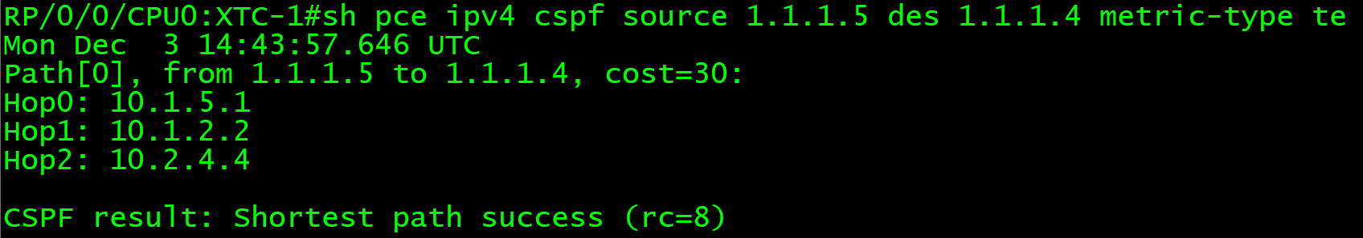
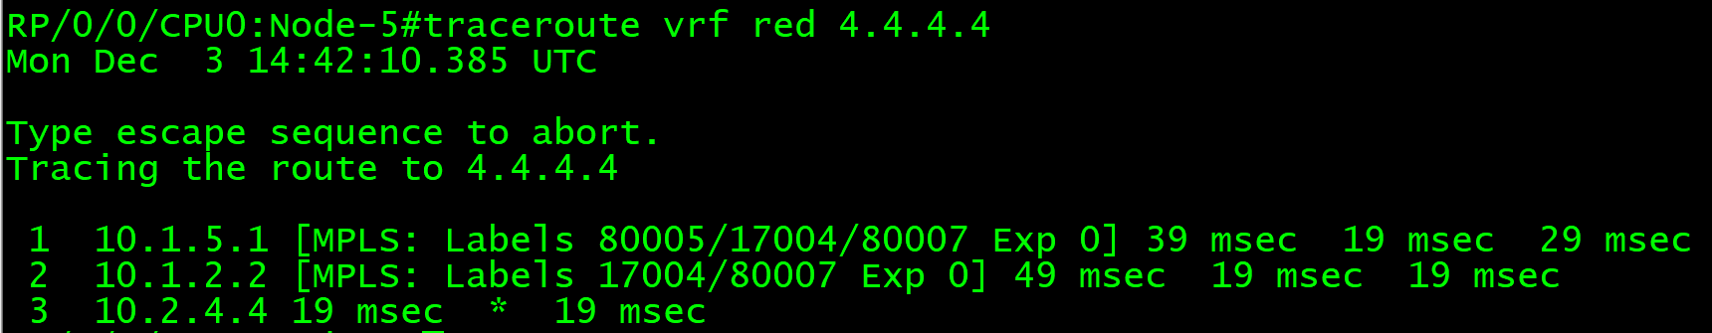
SRTE ODN LOW LATENCY – TE METRIC – VRF Prefix ON
segment-routing
traffic-eng
on-demand color 4
dynamic
pce
!
metric
type te
------------------------------------------------------------
RP/0/0/CPU0:Node-5#sh segment-routing traffic-eng pol
SR-TE policy database
---------------------
Name: bgp_AP_2 (Color: 4, End-point: 1.1.1.4)
Status:
Admin: up Operational: up for 00:00:18 (since Dec 3 14:41:21.321)
Candidate-paths:
Preference 100:
Dynamic (pce 1.1.1.201) (active)
Weight: 0, Metric Type: TE
Metric Type: TE, Path Accumulated Metric: 30
80001 [Adjacency-SID, 10.1.5.5 - 10.1.5.1]
80005 [Adjacency-SID, 10.1.2.1 - 10.1.2.2]
17004 [Prefix-SID, 1.1.1.4]
Attributes:
Binding SID: 80010
Allocation mode: dynamic
State: Programmed
Policy selected: yes
Forward Class: 0
Distinguisher: 0
Auto-policy info:
Creator: BGP
IPv6 caps enable: no

Slide 77
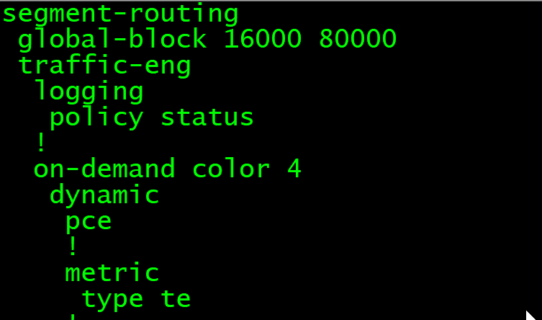
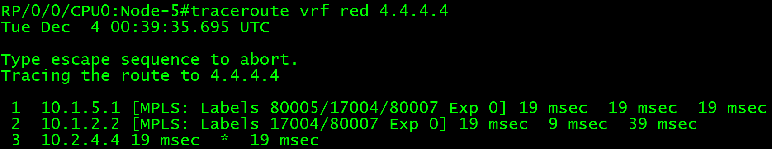
Node5- SRTE-ODN + XTC PCE
BGP VPN
5
201
251
XTC1
RR1
ISIS + SR
0/0
0/0
PCEP
+
XTC BGP SR CTRL
0/5
4.4.4.4 C4
0/0
0/0
0/1
0/0
5
IGP = 100
1
IGP = 100
2
0/2
0/3
0/4
0/2
0/1
0/2
0/1
0/0
0/2
0/0
0/2
8
3
0/1
0/3
0/1
0/3
0/0
0/2
0/1
4.4.4.4
40.40.40.40
44.44.44.44
0/2
0/3
0/4
0/2
IGP = 100
IGP = 100
6
0/1
0/0
7
0/1
0/0
4

Slide 78
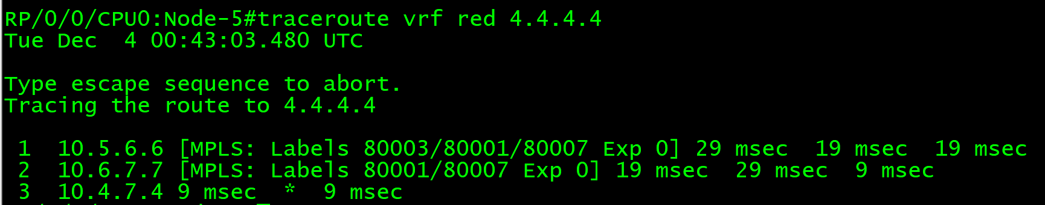
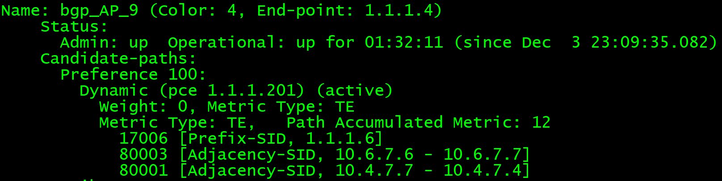
Node5- SRTE-ODN + XTC PCE ( Link Failure )
BGP VPN
5
201
251
XTC1
RR1
ISIS + SR
0/0
0/0
PCEP
+
XTC BGP SR CTRL
0/5
4.4.4.4 C4
0/0
0/0
0/1
0/0
5
IGP = 100
1
IGP = 100
2
0/2
0/3
0/4
0/2
0/1
0/2
0/1
0/0
0/2
0/0
0/2
8
3
0/1
0/3
0/1
0/3
0/0
0/2
0/1
4.4.4.4
40.40.40.40
44.44.44.44
0/2
0/3
0/4
0/2
IGP = 100
IGP = 100
6
0/1
0/0
7
0/1
0/0
4

Slide 79
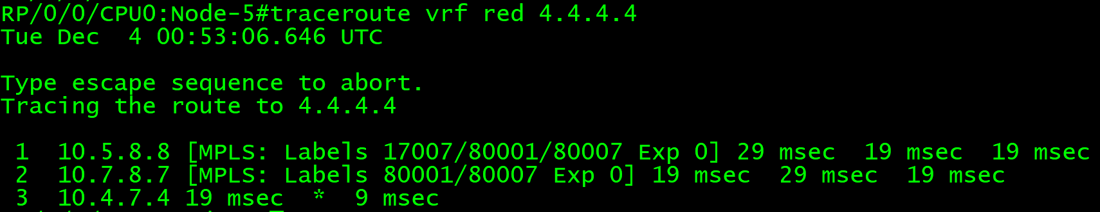
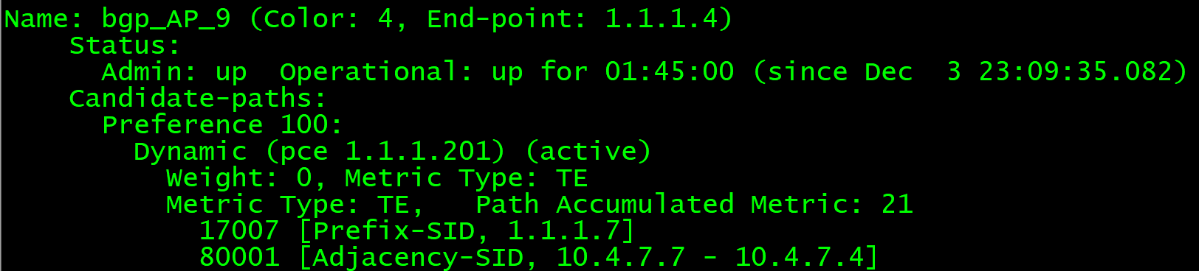
Node5- SRTE-ODN + XTC PCE ( Delay Incident )
BGP VPN
5
201
251
XTC1
RR1
ISIS + SR
0/0
0/0
PCEP
+
XTC BGP SR CTRL
0/5
4.4.4.4 C4
0/0
0/0
0/1
0/0
5
IGP = 100
1
IGP = 100
2
0/2
0/3
0/4
0/2
0/1
0/2
0/1
0/0
0/2
0/0
0/2
8
3
0/1
0/3
0/1
0/3
0/0
0/2
0/1
4.4.4.4
40.40.40.40
44.44.44.44
0/2
0/3
0/4
0/2
IGP = 100
IGP = 100
6
0/1
0/0
7
0/1
0/0
4

Slide 80
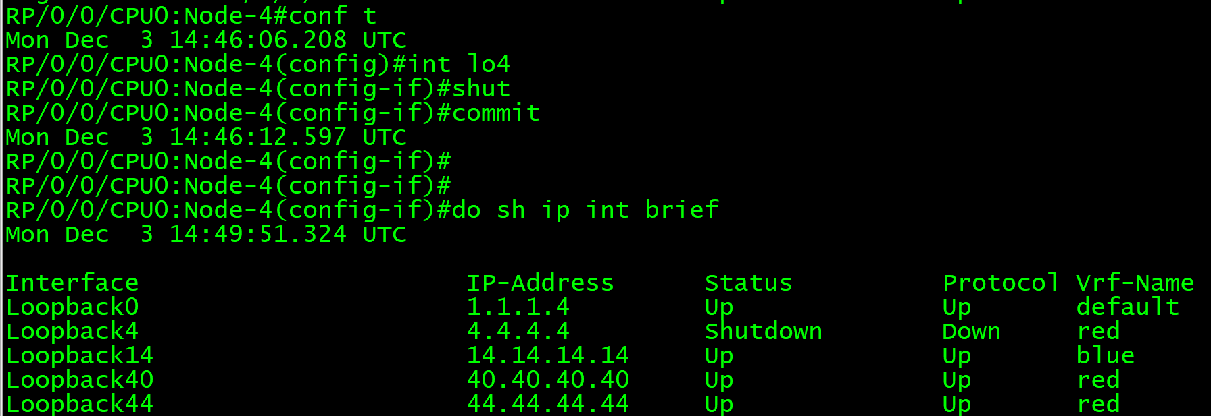
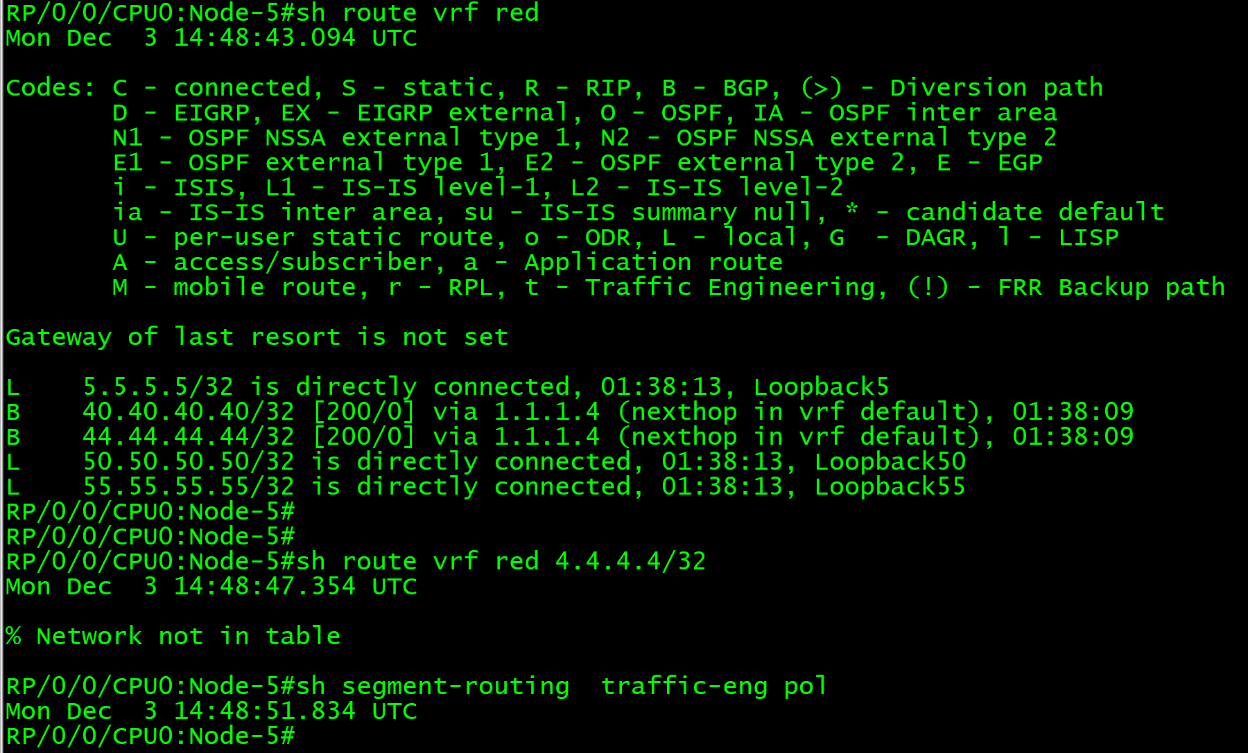
SRTE ODN – VRF Prefix OFF

Slide 81
Clear SR Policy

Slide 82
Clear SR Policy
5
1
2
8
3
6
7
4
Python Node-5 no-odn-c4
Python Node-4 no-odn-c5
@Node5, 4
Show segment traffic policy
Trace before python
Trace after python

Slide 83
17. Segment Routing PCE REST API

Slide 84
SR PCE REST
RP/0/0/CPU0:XTC-1#sh run pce
Sun Feb 3 02:36:53.445 UTC
pce
address ipv4 1.1.1.201
rest
user cisco
password encrypted 00071A150754 (type password clear cisco – automatically encrypted)
!
authentication basic
!
logging
no-path
fallback
!
state-sync ipv4 1.1.1.202
password encrypted 121A0C041104

Slide 85
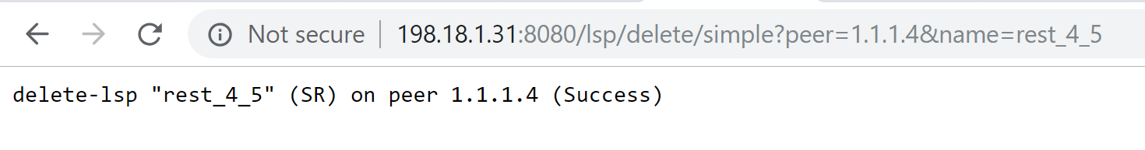
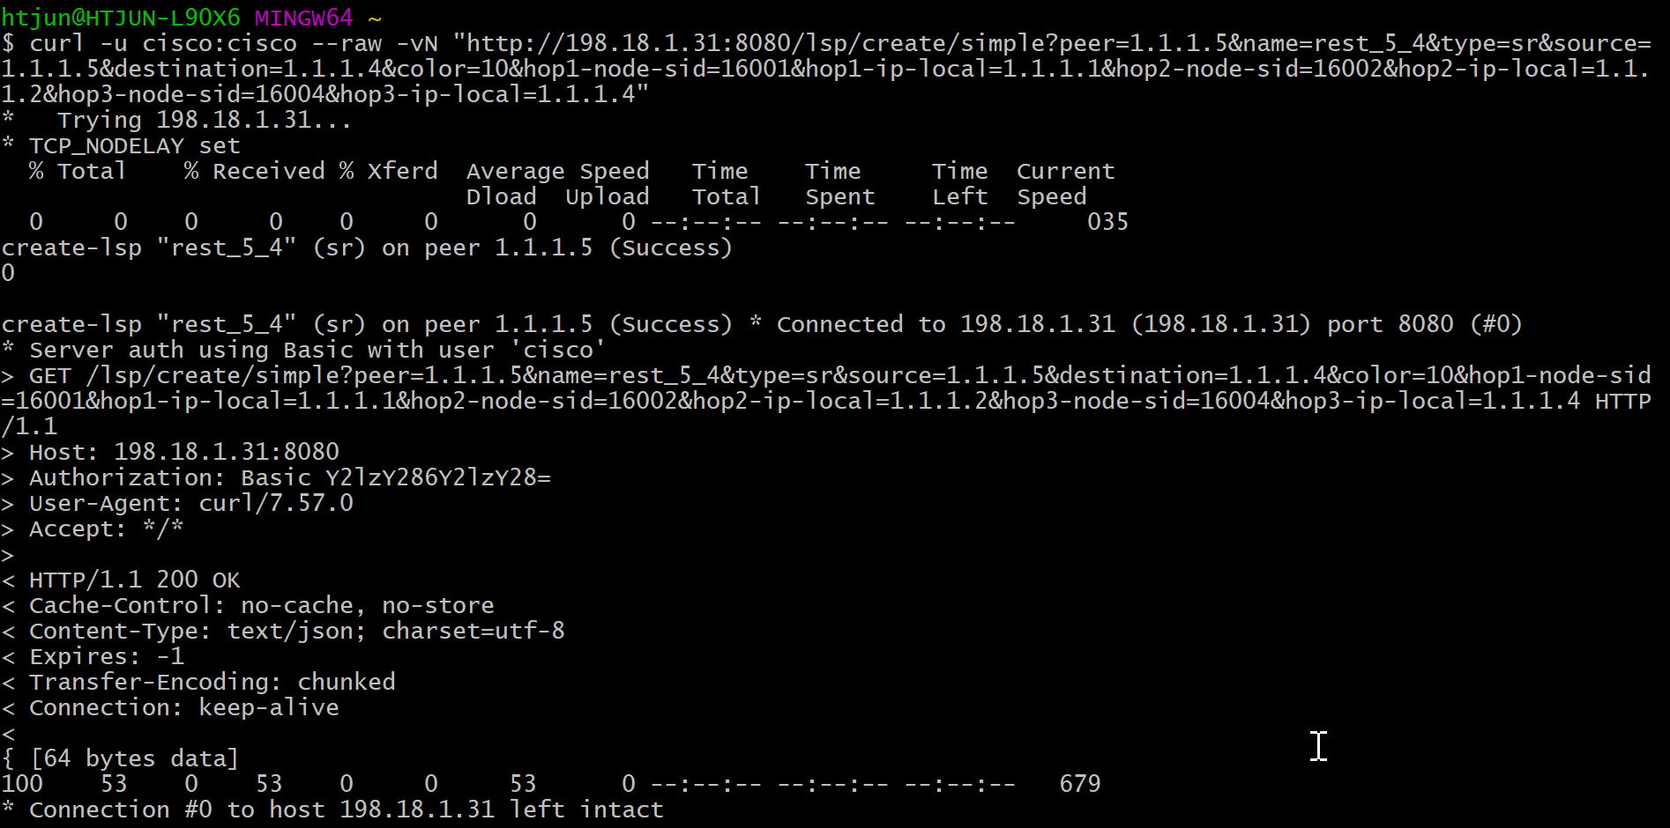
SR PCE REST client – curl & browser

Slide 86
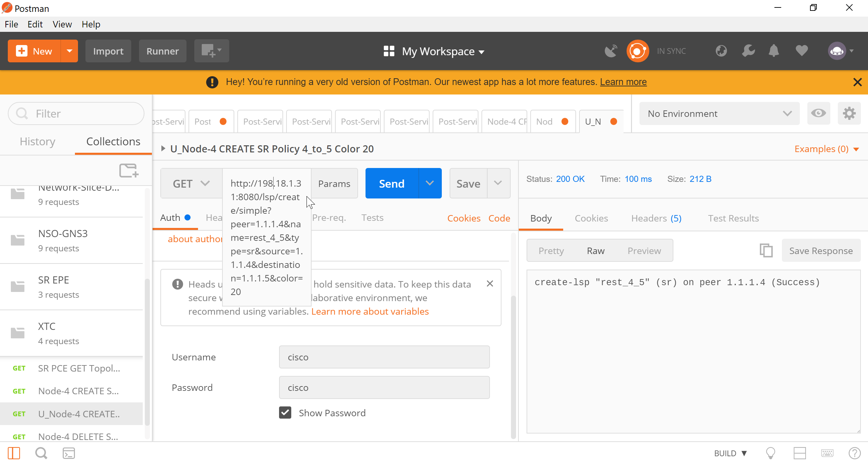
SR PCE REST client - postman

Slide 87
SR PCE REST create_lsp parameter -1
/lsp/create/simple – rest url
peer=1.1.1.2 – pcc (tunnel headend router) address
name=rest_2_4 – tunnel name, max name length is restricted to 128 characters. Name cannot contains spaces or special characters (allowed are '-', '_', '(', ')')
type=sr – setup type. If not specified SR is assumed. Allowed values are sr or rsvp
source=1.1.1.2 – tunnel source address. If not specified "peer" address will be used instead
allow-xtc-reoptimization=0 - REST client prevents XTC to update lsp with new path e.g. in case of link down and REST client has to update path itself. Default value is 1, in that case XTC is allowed to modify lsp.
destination=1.1.1.4 – tunnel destination address
color=10 – SR policy color, mandatory when creating SR policy (not needed for rsvp lsps)
preference=10 – SR policy path preference, default value is 100, (not needed for rsvp lsps)

Slide 88
SR PCE REST create_lsp parameter -2
metric-igp=10 - using igp metric as path computation constraint
metric-te=10 - using te metric as path computation constraint
metric-latency=10 - using latency metric as path computation constraint
hop1-adj-sid=24001&hop1-ip-local=99.1.2.2&hop1-ip-remote=99.1.2.1 – path’s first hop defined by adj-sid
hop2-adj-sid=28099&hop2-ip-local=99.1.3.1&hop2-ip-remote=99.1.3.3 – path’s second hop defined by adj-sid
hop3-adj-sid=24003&hop3-ip-local=99.3.4.3&hop3-ip-remote=99.3.4.4 – path’s third hop defined by adj-sid
hopX-node-sid=30001&hopX-ip-local=1.1.1.1
Example: (no_space)
curl --raw -vN "http://<xtc-ip-addr>:8080/lsp/create/simple?peer=1.1.1.2&name=rest_2_4&type=sr
&source=1.1.1.2&destination=1.1.1.4&color=10
&hop1-adj-sid=24001&hop1-ip-local=99.1.2.2&hop1-ip-remote=99.1.2.1
&hop2-adj-sid=28099&hop2-ip-local=99.1.3.1&hop2-ip-remote=99.1.3.3
&hop3-adj-sid=24003&hop3-ip-local=99.3.4.3&hop3-ip-remote=99.3.4.4"

Slide 89
SR PCE REST update_lsp parameter
/lsp/update/simple – rest url
peer=1.1.1.2 – pcc (tunnel headend router) address
name=rest_2_4 – tunnel name, max name length is restricted to 128 characters. Name cannot contains spaces or special characters (allowed are '-', '_', '(', ')')
type=sr – setup type. If not specified SR is assumed
hop1-adj-sid=24001&hop1-ip-local=99.1.2.2&hop1-ip-remote=99.1.2.1 – path’s first hop defined by adj-sid
hop2-adj-sid=28099&hop2-ip-local=99.1.3.1&hop2-ip-remote=99.1.3.3 – path’s second hop defined by adj-sid
hop3-adj-sid=24003&hop3-ip-local=99.3.4.3&hop3-ip-remote=99.3.4.4 – path’s third hop defined by adj-sid
Example: (no_space)
curl --raw -vN "http://<xtc-ip-addr>:8080/lsp/update/simple?peer=1.1.1.2&name=rest_2_4
&hop1-adj-sid=24001&hop1-ip-local=99.1.2.2&hop1-ip-remote=99.1.2.1
&hop2-adj-sid=28099&hop2-ip-local=99.1.3.1&hop2-ip-remote=99.1.3.3
&hop3-adj-sid=24003&hop3-ip-local=99.3.4.3&hop3-ip-remote=99.3.4.4"

Slide 90
SR PCE REST delete_lsp parameter
/lsp/delete/simple – rest url
peer=1.1.1.2 – pcc (tunnel headend router) address
name=rest_2_4 – tunnel name, max name length is restricted to 128 characters. Name cannot contains spaces or special characters (allowed are '-', '_', '(', ')’)
Example:
curl --raw -vN “http://<xtc-ip-addr>:8080/lsp/delete/simple?peer=1.1.1.2&name=rest_2_4”

Slide 91
Sample Lab
curl -u cisco:cisco --raw -vN "http://198.18.1.31:8080/lsp/create/simple?peer=1.1.1.5&name=rest_5_4&type=sr&source=1.1.1.5&destination=1.1.1.4&color=4&hop1-adj-sid=80001&hop1-ip-local=10.1.5.5&hop1-ip-remote=10.1.5.1&hop2-adj-sid=80001&hop2-ip-local=10.1.2.1&hop2-ip-remote=10.1.2.2&hop3-adj-sid=80006&hop3-ip-local=10.2.4.2&hop3-ip-remote=10.2.4.4"
curl -u cisco:cisco --raw -vN "http://198.18.1.31:8080/lsp/create/simple?peer=1.1.1.5&name=rest_5_4&type=sr&source=1.1.1.5&destination=1.1.1.4&color=10&hop1-node-sid=16001&hop1-ip-local=1.1.1.1&hop2-node-sid=16002&hop2-ip-local=1.1.1.2&hop3-node-sid=16004&hop3-ip-local=1.1.1.4"
curl -u cisco:cisco --raw -vN "http://198.18.1.31:8080/lsp/delete/simple?peer=1.1.1.5&name=rest_5_4"
curl -u cisco:cisco --raw -vN "http://198.18.1.31:8080/lsp/create/simple?peer=1.1.1.4&name=rest_4_5&type=sr&source=1.1.1.4&destination=1.1.1.5&color=20"
curl -u cisco:cisco --raw -vN "http://198.18.1.31:8080/lsp/create/simple?peer=1.1.1.4&name=rest_4_5&type=sr&source=1.1.1.4&destination=1.1.1.5&color=20&metric-igp=10"
curl -u cisco:cisco --raw -vN "http://198.18.1.31:8080/lsp/delete/simple?peer=1.1.1.4&name=rest_4_5"
curl -u cisco:cisco --raw -vN "http://198.18.1.31:8080/lsp/delete/simple?peer=1.1.1.4&name=rest_4_5"

Slide 92
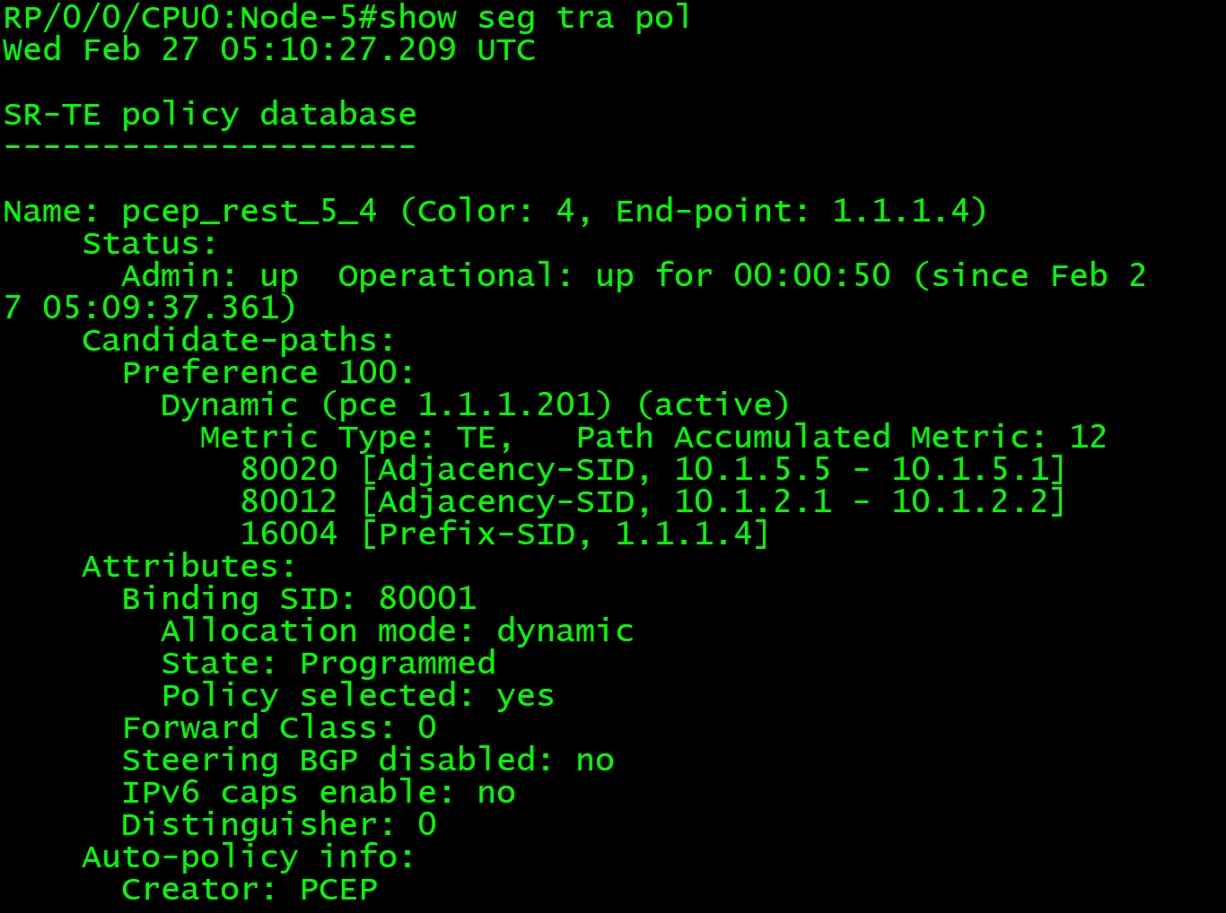
Lab1a
curl -u cisco:cisco --raw -vN "http://198.18.1.31:8080/lsp/create/simple?
peer=1.1.1.5
&name=rest_5_4
&type=sr&source=1.1.1.5
&destination=1.1.1.4
&color=4
&metric-te=10“

Slide 93
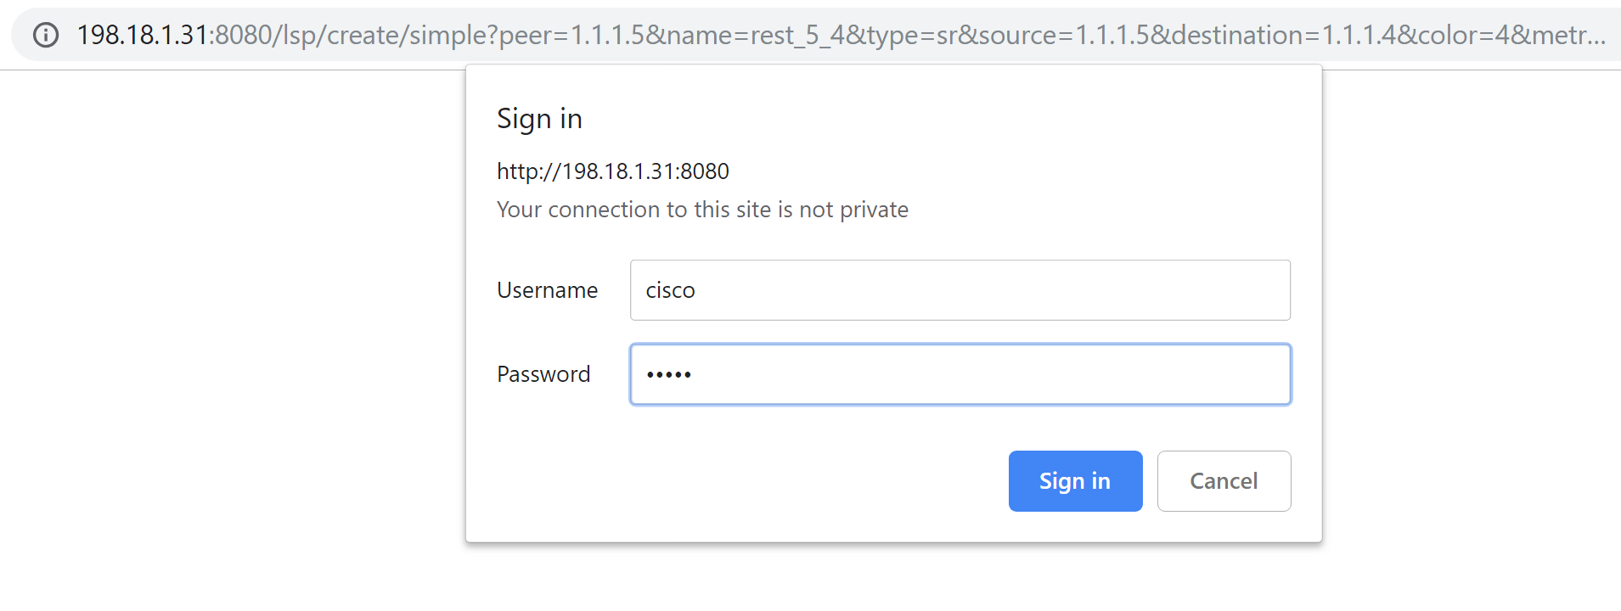
Lab1
curl -u cisco:cisco --raw -vN "http://198.18.1.31:8080/lsp/create/simple?
peer=1.1.1.5
&name=rest_5_4
&type=sr&source=1.1.1.5
&destination=1.1.1.4
&color=4
&metric-te=10“

Slide 94
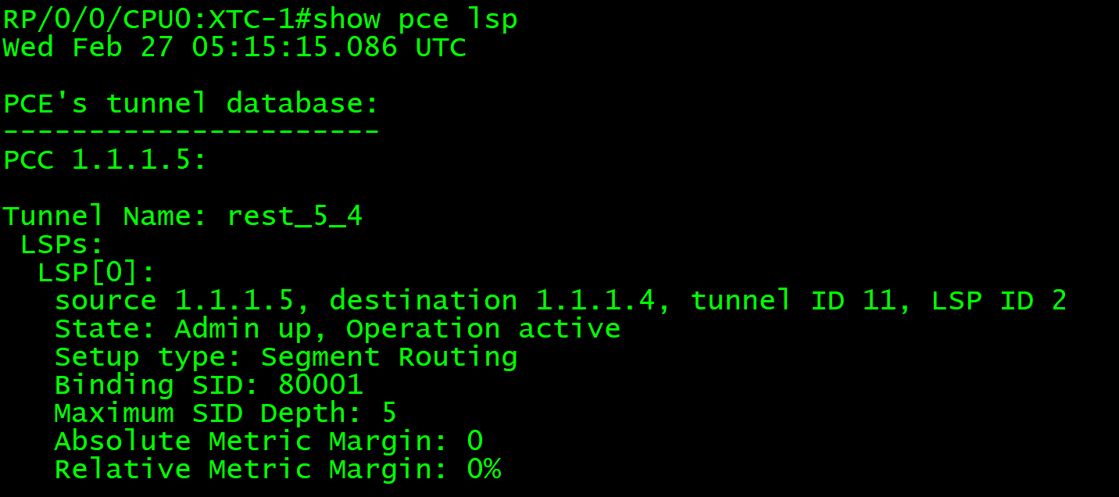
SR PCE Verification
RP/0/0/CPU0:XTC-1#show pce lsp detail
Wed Feb 27 05:15:23.945 UTC
PCE's tunnel database:
----------------------
PCC 1.1.1.5:
Tunnel Name: rest_5_4
LSPs:
LSP[0]:
source 1.1.1.5, destination 1.1.1.4, tunnel ID 11, LSP ID 2
State: Admin up, Operation active
Setup type: Segment Routing
Binding SID: 80001
Maximum SID Depth: 5
Absolute Metric Margin: 0
Relative Metric Margin: 0%
Bandwidth: signaled 0 kbps, applied 0 kbps
PCEP information:
PLSP-ID 0x8000b, flags: D:1 S:0 R:0 A:1 O:2 C:1
LSP Role: Single LSP
State-sync PCE: None
PCC: 1.1.1.5
LSP is subdelegated to: None
Reported path:
Metric type: TE, Accumulated Metric 12
SID[0]: Adj, Label 80020, Address: local 10.1.5.5 remote 10.1.5.1
SID[1]: Adj, Label 80012, Address: local 10.1.2.1 remote 10.1.2.2
SID[2]: Node, Label 16004, Address 1.1.1.4
Computed path: (Local PCE)
Computed Time: Wed Feb 27 05:09:36 UTC 2019 (00:05:48 ago)
Metric type: TE, Accumulated Metric 12
SID[0]: Adj, Label 80020, Address: local 10.1.5.5 remote 10.1.5.1
SID[1]: Adj, Label 80012, Address: local 10.1.2.1 remote 10.1.2.2
SID[2]: Node, Label 16004, Address 1.1.1.4
Recorded path:
None
Disjoint Group Information:
None
@SR PCE
Show pce lsp
Show pce lsp detail
Show pce lsp summary

Slide 95
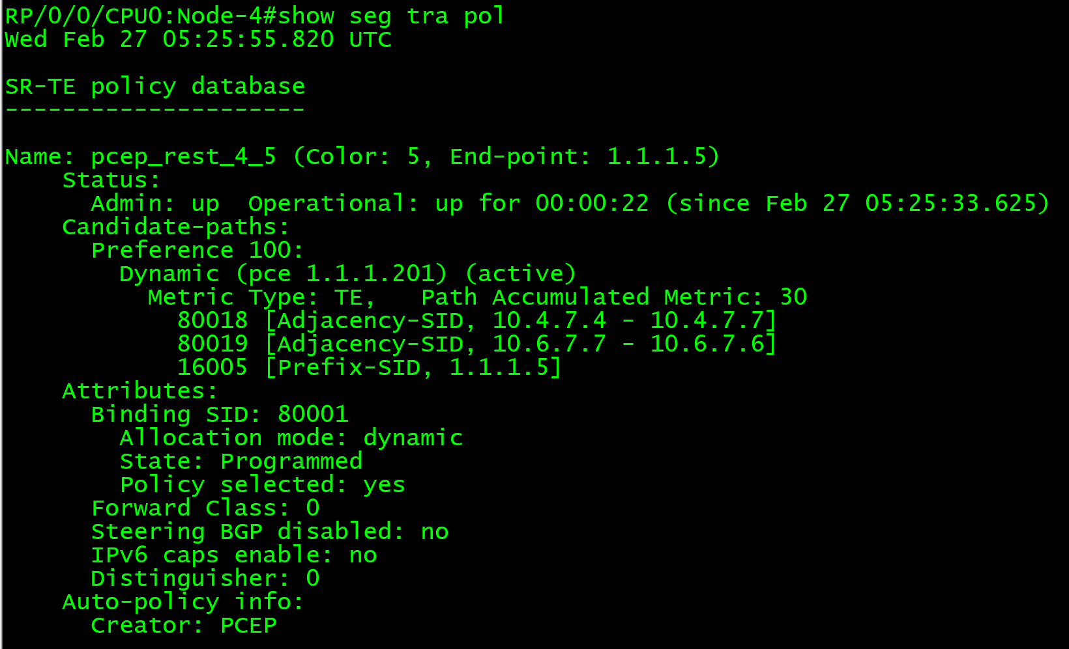
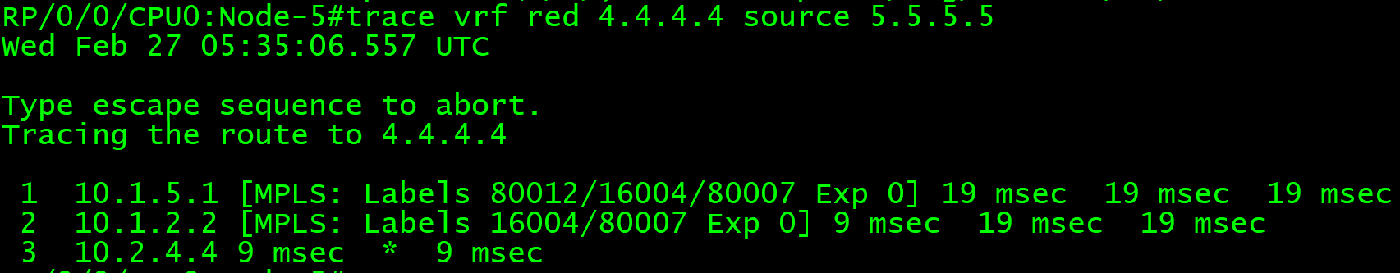
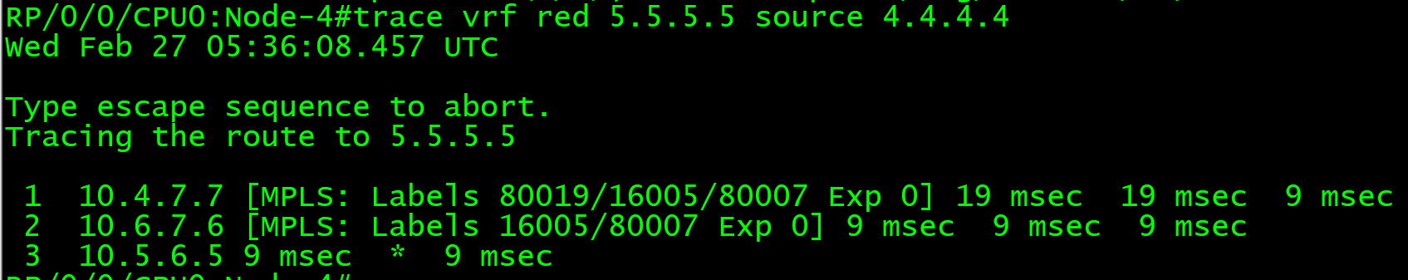
Lab1b
curl -u cisco:cisco --raw -vN "http://198.18.1.31:8080/lsp/create/simple?
peer=1.1.1.4
&name=rest_4_5
&type=sr&source=1.1.1.4
&destination=1.1.1.5
&color=5
&metric-te=10“

Slide 96
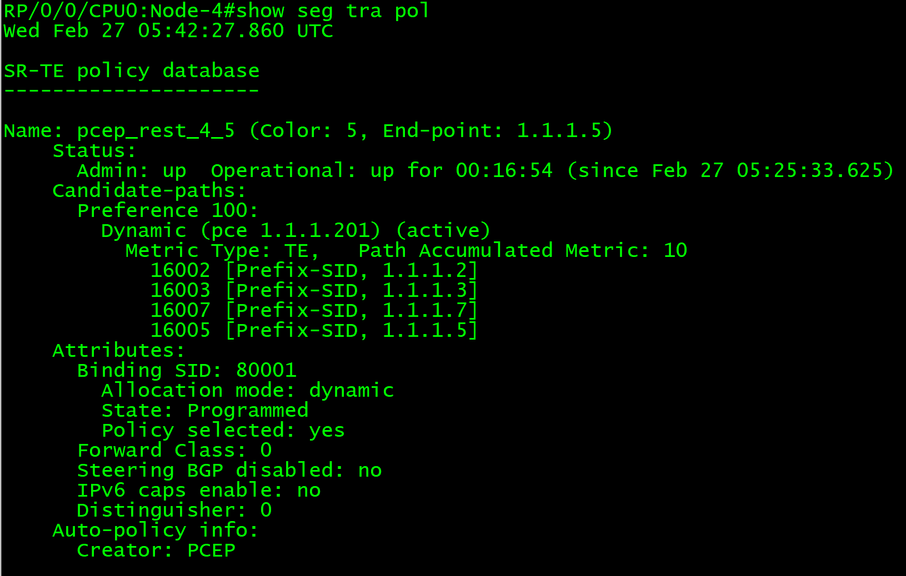
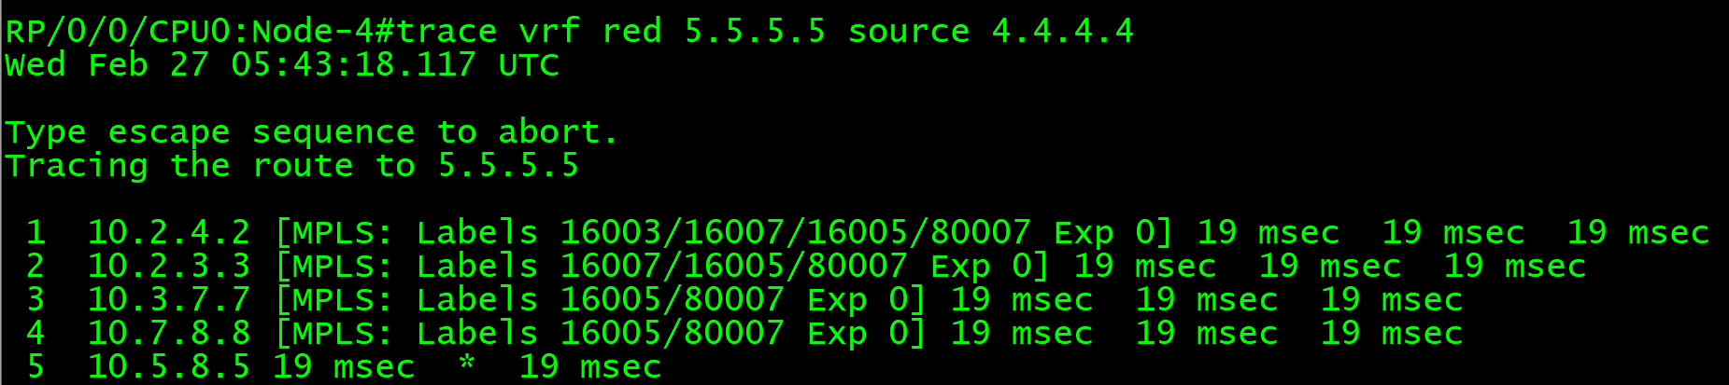
Lab2
curl -u cisco:cisco --raw -vN "http://198.18.1.31:8080/lsp/update/simple?
peer=1.1.1.4
&name=rest_4_5
&type=sr&source=1.1.1.4
&destination=1.1.1.5
&color=5
&hop1-node-sid=16002&hop1-ip-local=1.1.1.2
&hop2-node-sid=16003&hop2-ip-local=1.1.1.3
&hop3-node-sid=16007&hop3-ip-local=1.1.1.7
&hop4-node-sid=16005&hop4-ip-local=1.1.1.5
&metric-te=10“

Slide 97
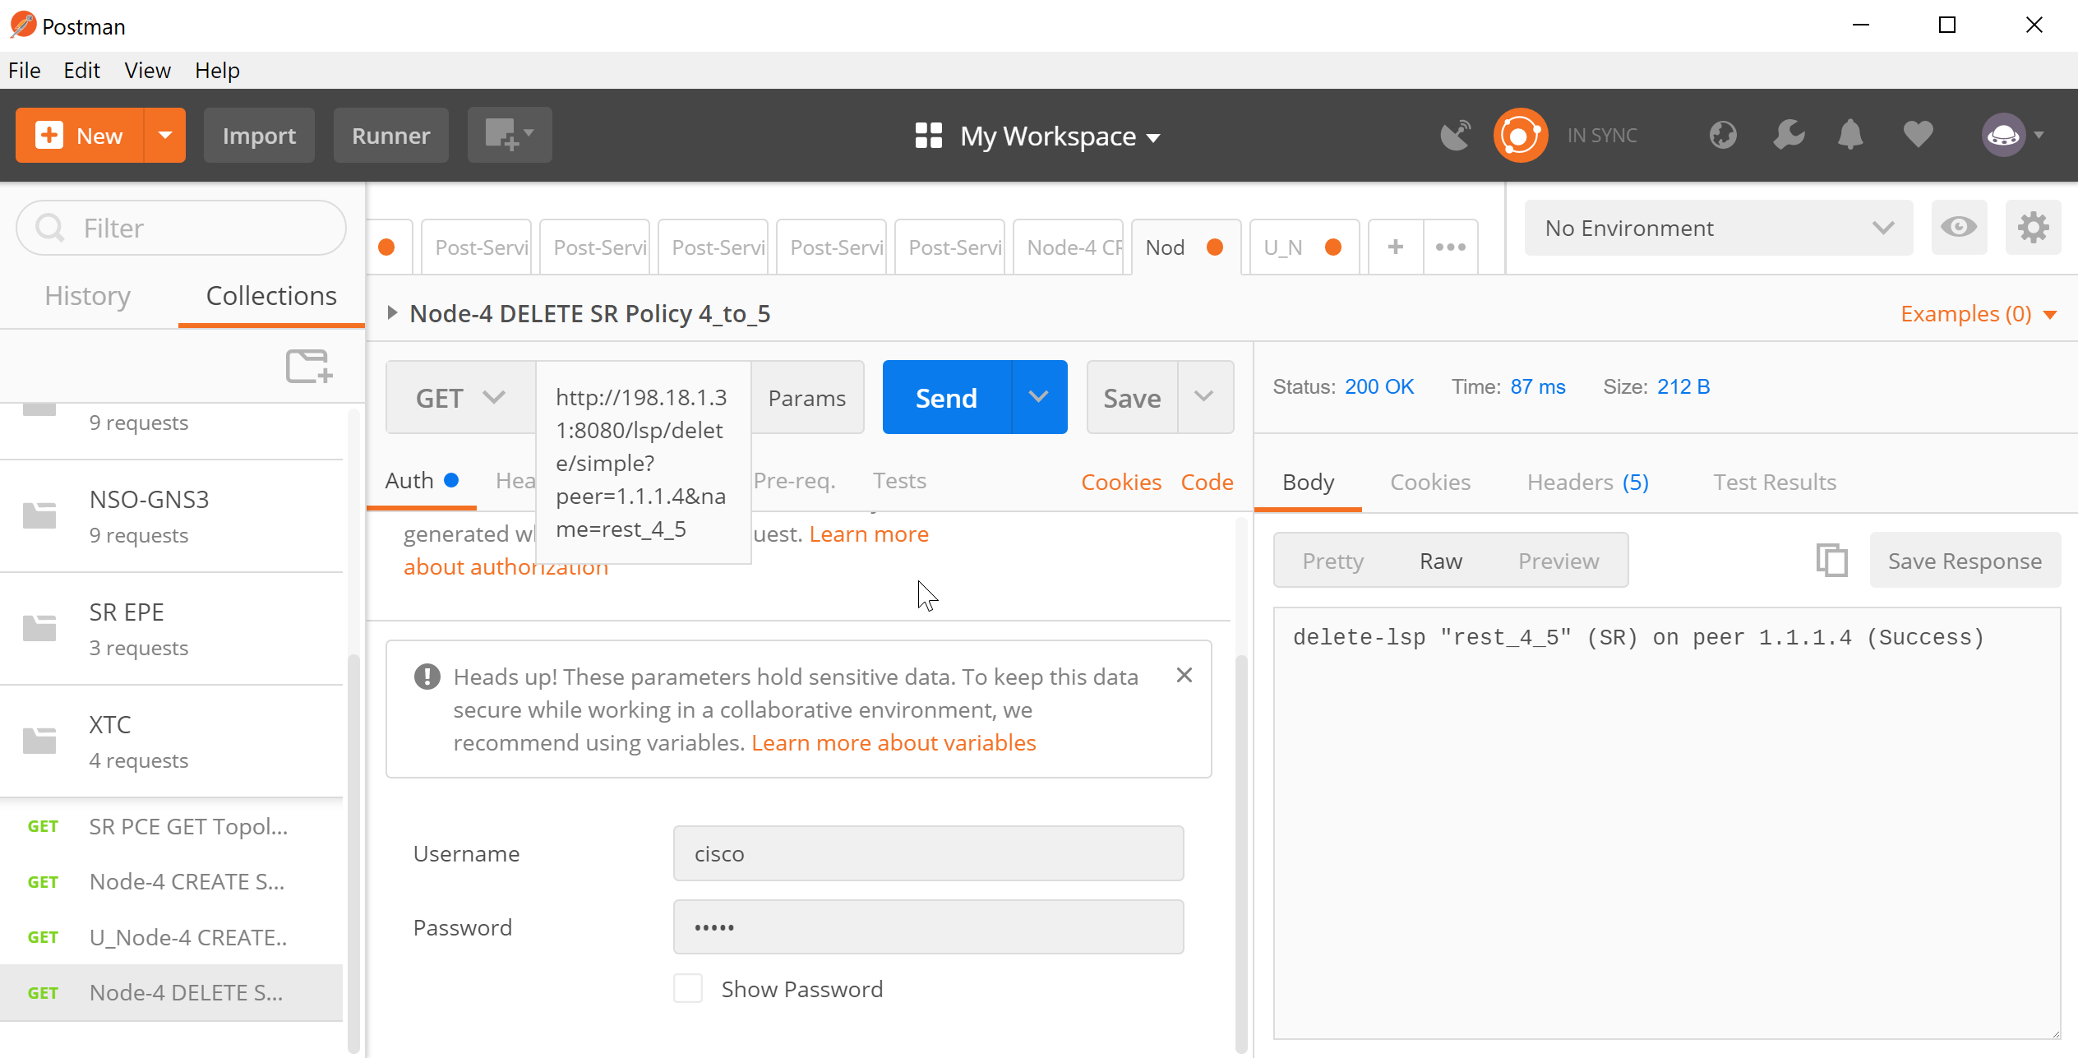
Lab3

Slide 98
18.Network Slicing Automation SR On-Demand-NextHop + XTC + NSO

Slide 99
Demo – Why ?
Can a Telco create Network Slices mapping to specific transport SLA requirements/intent ?
Including network bandwidth
Including network delay
Including path disjointness
Can Traffic Engineered (TE) path be created On-Demand from anywhere to anywhere in a given network slice ?
Can Traffic be Automatically Steered onto these On-Demand TE paths ?

Slide 100


Demo Topology
BGP VPN
Green Link = Low-Latency Link
Red Link = Normal Link
= Low Latency Traffic
OSPF + SR
+
NSO
XTC
RR
XTC
Low Delay
Transport Link
High Delay Transport Link
0/1
5
1
2
0/1
Biz CPE
8
3
0/0
0/1
6
7
4
ospf area 0
ospf area 0
Biz CPE

Slide 101
Segment Routing + Seamless MPLS Architecture
for Simple, Flexible and Scalable Network
Multiple IGP domain with BGP LU or SDN Controller
Large Scale and Flexible Network (up to 100.000)
More Stable Network – Isolated Network Change Impact
0/1
5
Smaller Route Table
R1 and R7 as Gateway to Other IGP Domain
Learn from SDN Controller
Route to other IGP Domain Router
1
2
0/1
Biz CPE
8
3
0/0
0/1
6
ospf area 0
SR Network
7
ospf area 0
SR Network
4
Biz CPE

Slide 102
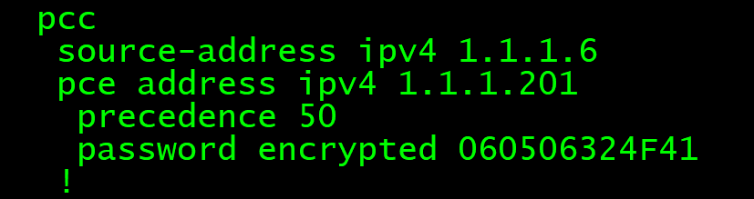
Demo Learn On-Demand Path from XTC via PCEP
show run segment-routing
XTC
0/1
5
IGP = 100
1
IGP = 100
2
0/1
Biz CPE
8
3
0/0
0/1
IGP = 100
IGP = 100
6
7
4
Biz CPE

Slide 103
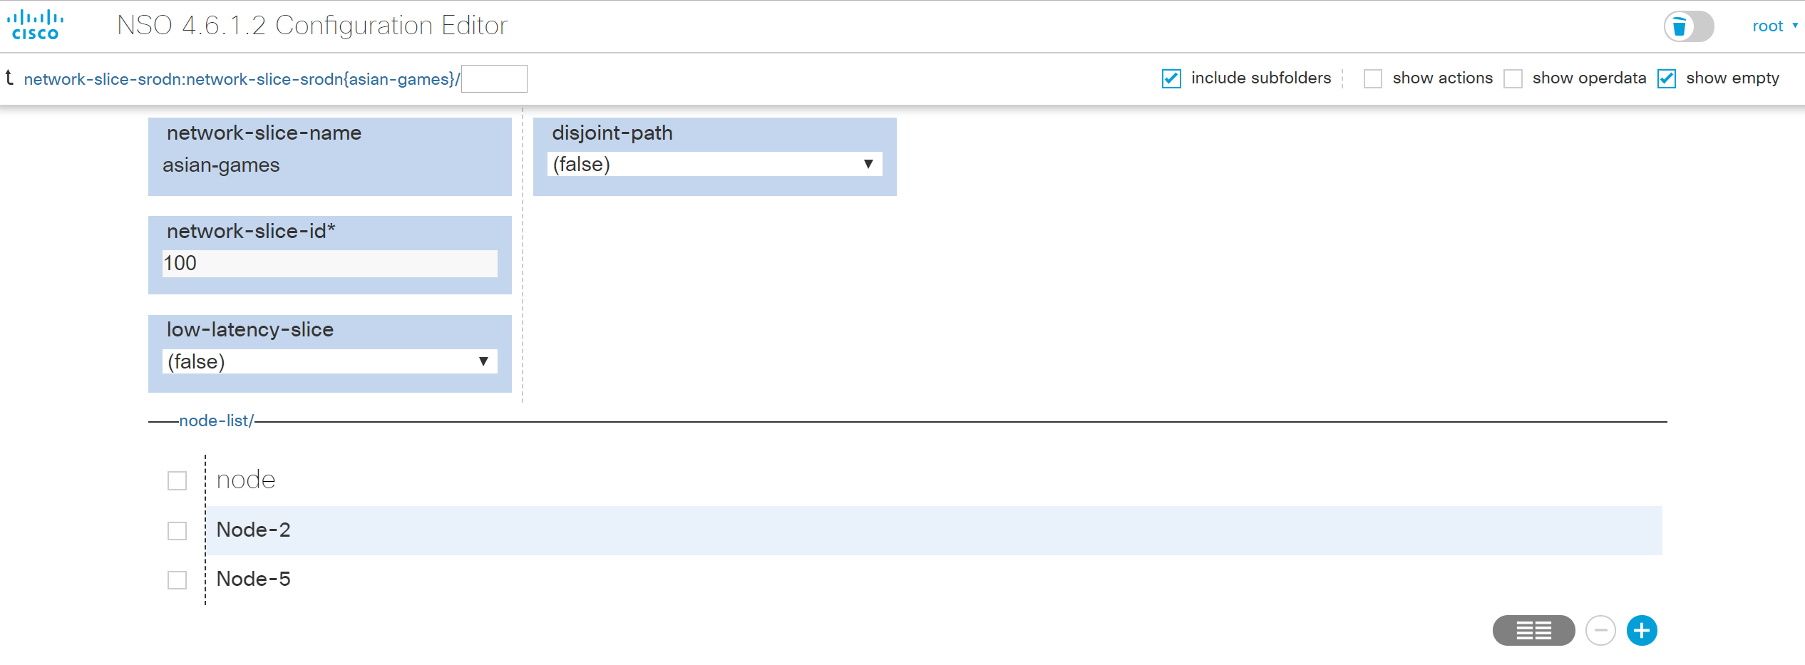
Demo Network Slice Creation

Slide 104
Demo Network Slice Creation
NSO
network-slice :
asian-games
5
2
0/1
0/1
Biz CPE

Slide 105
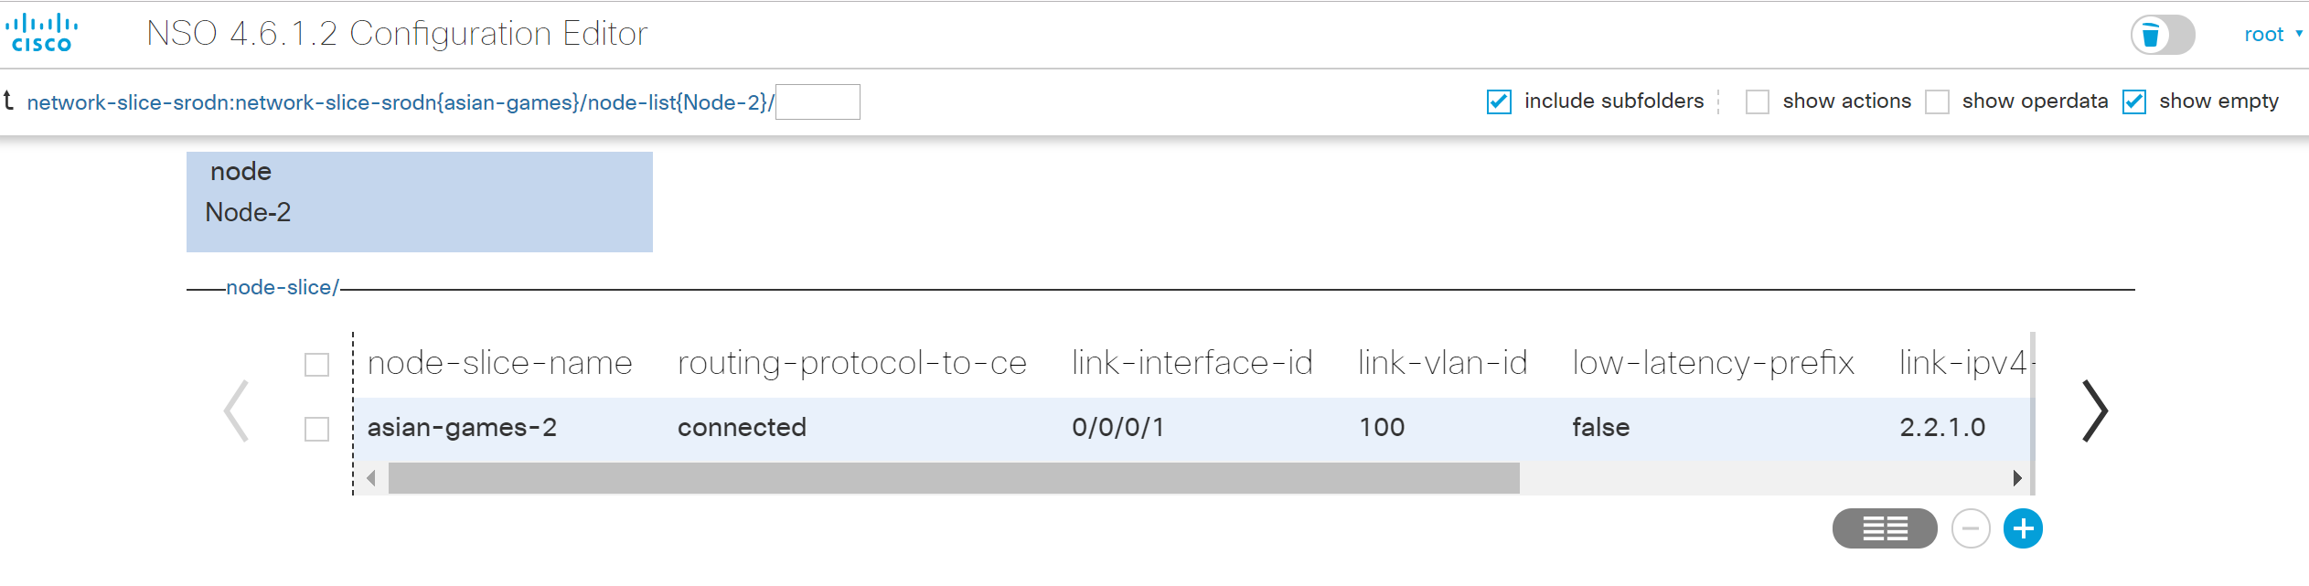
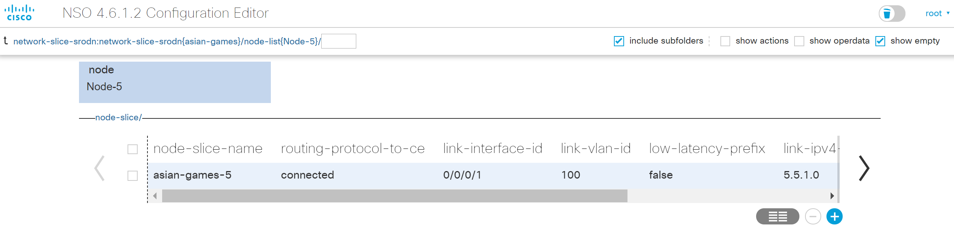
Demo Node Slice for Service Application

Slide 106
Demo Node Slice Creation
NSO
0/1
network-slice :
asian-games
5
2
0/1
asian-games-2
Biz CPE
asian-games-5

Slide 107
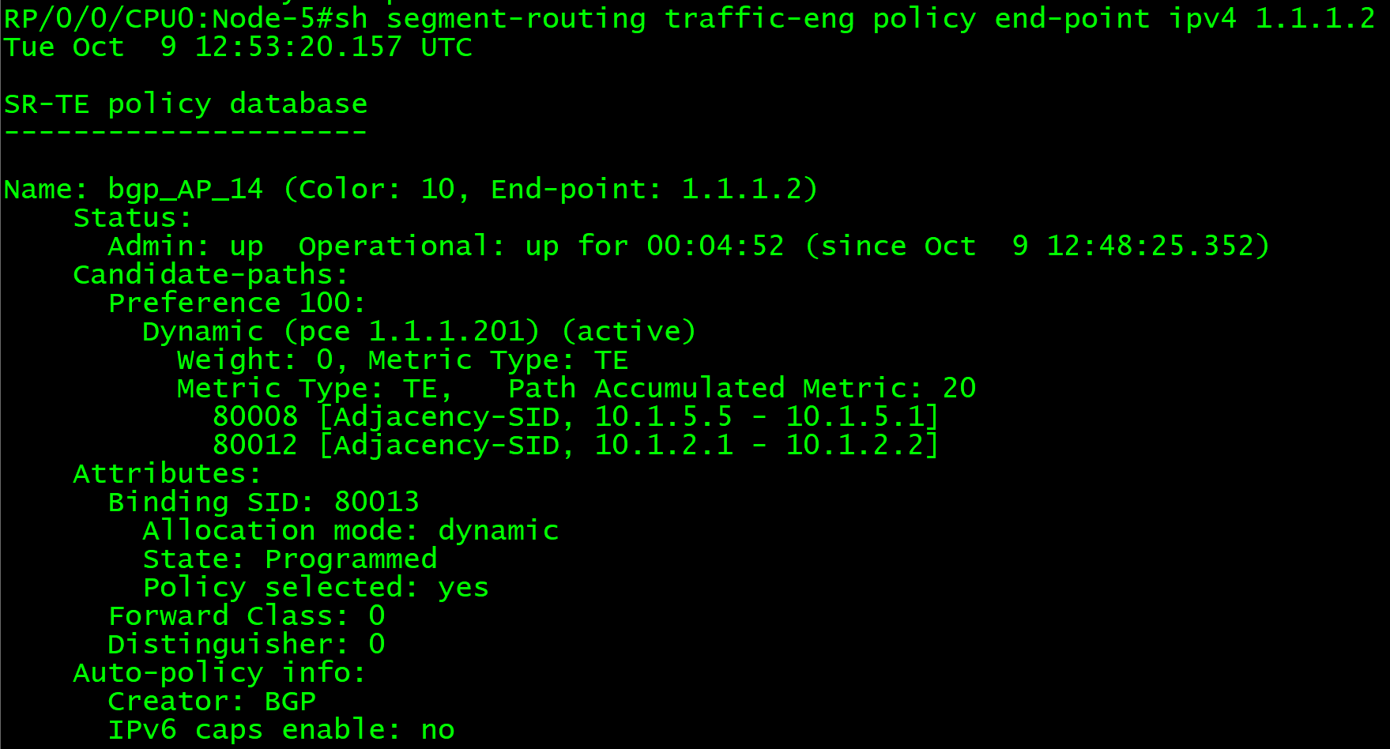
Demo Segment Routing On Demand NextHop (BGP)
NSO
asian-games-5
asian-games-2
0/1
network-slice :
asian-games
5
2
0/1
Biz CPE

Slide 108
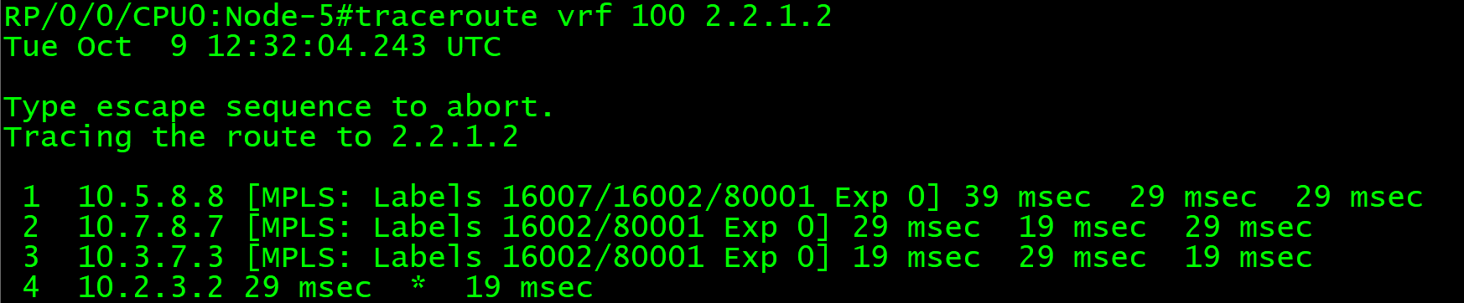
Demo SR On-Demand
Automated Steered TE Path – Normal Path
0/1
network-slice :
asian-games
5
2
0/1
Biz CPE
asian-games-2
asian-games-5
8
3
7

Slide 109
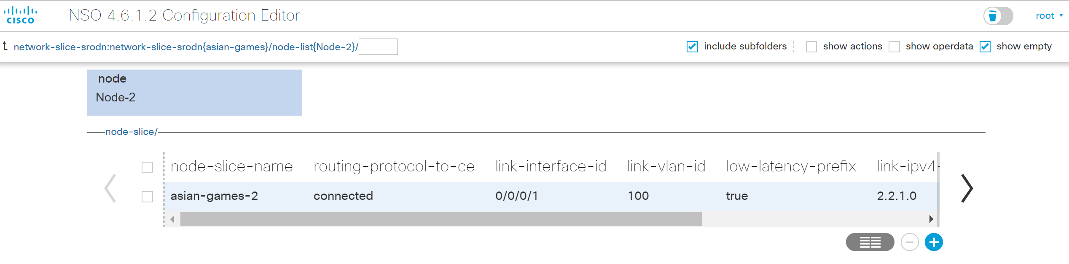
Demo Node Slice for Service Application

Slide 110
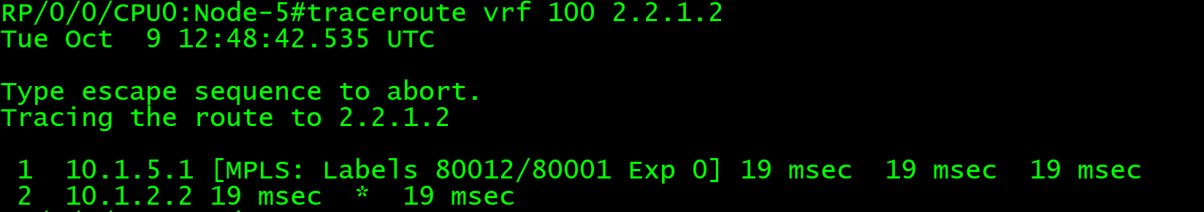
Demo SR On-Demand
Automated Steered TE Path – Low Latency Path
0/1
network-slice :
asian-games
5
1
2
0/1
Biz CPE
asian-games-2
asian-games-5

Slide 111
Demo Traffic Service Maps to Transport SLA Intent
4g-v401-ip5-signalling
0/1
4g-v402-ip5-bearer
4g-v403-ip5-oam
network-slice :
4g-slice400-jakarta
5
IGP = 100
1
IGP = 100
4g-v401-ip4-signalling
4g-v401-ip6-signalling
8
3
4g-v402-ip4-bearer
4g-v402-ip6-bearer
4g-v403-ip4-oam
4g-v403-ip6-oam
0/0
0/1
IGP = 100
IGP = 100
6
7
4

Slide 112
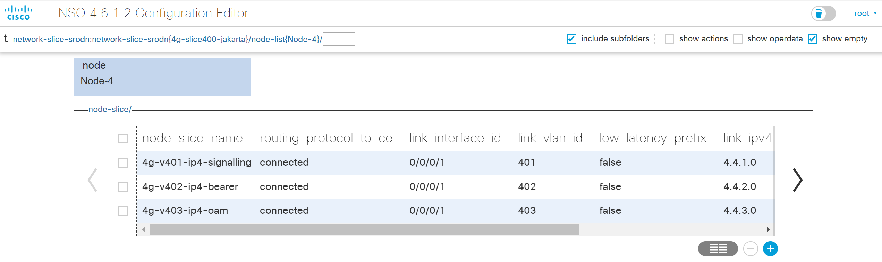
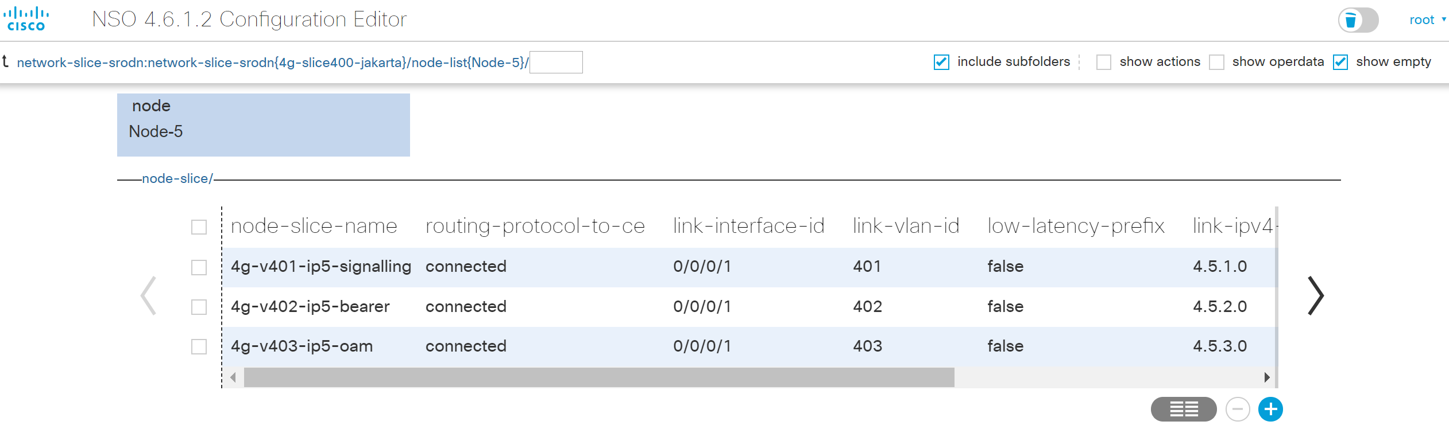
Demo Traffic Service Maps to Transport SLA Intent

Slide 113
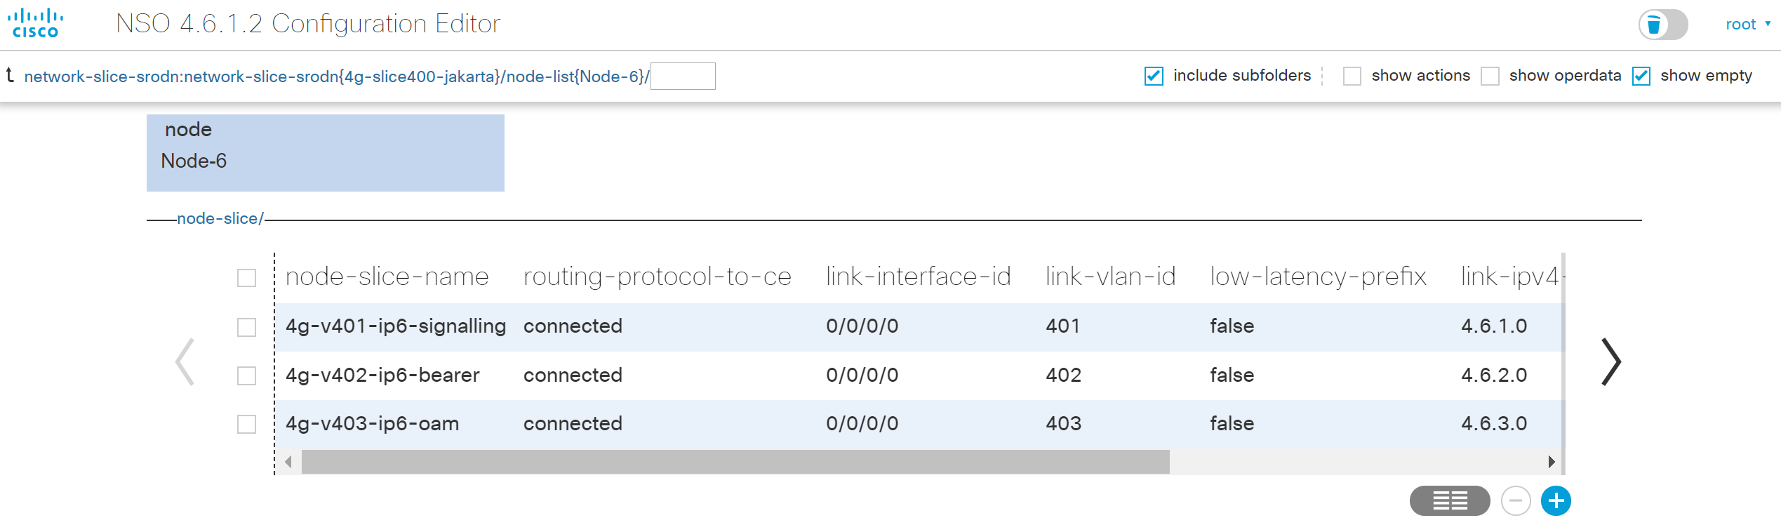

Slide 114
Demo Network Slice Creation
NSO
network-slice :
4g-slice400-jakarta
5
0/1
Biz CPE
0/0
0/1
6
4
Biz CPE

Slide 115
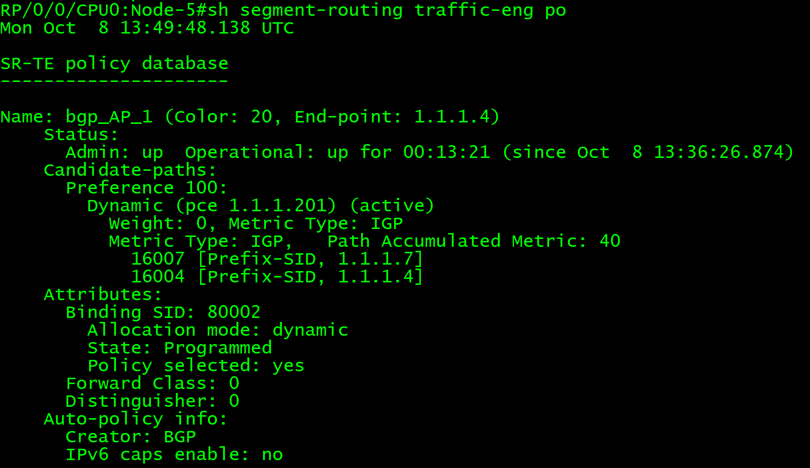
Demo Segment Routing On Demand NextHop (BGP)
0/1
4g-v401-ip5-signalling
network-slice :
4g-slice400-jakarta
5
IGP = 100
1
IGP = 100
4g-v401-ip4-signalling
8
3
4g-v402-ip4-bearer
4g-v401-ip6-signalling
4g-v403-ip4-oam
IGP = 100
IGP = 100
0/1
6
7
4

Slide 116
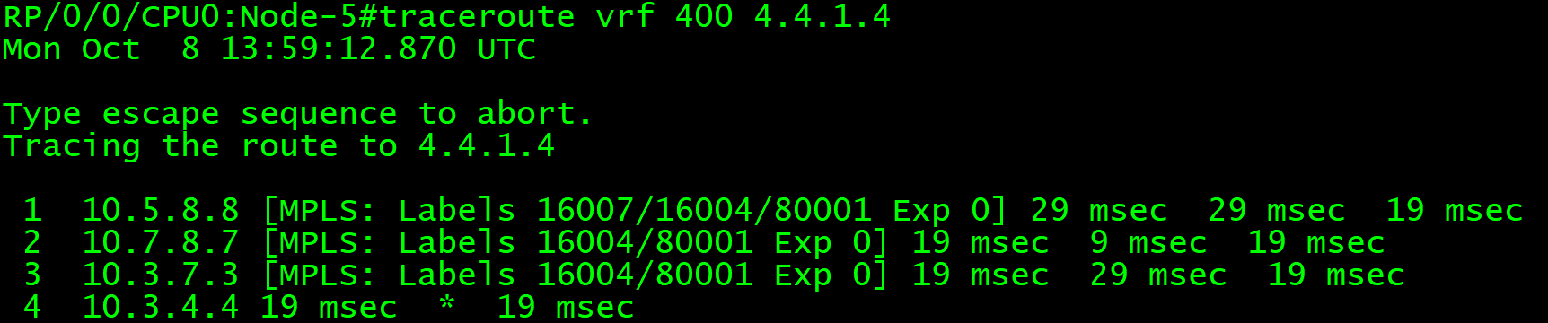
Demo SR On-Demand
Automated Steered TE Path – Normal Path
4g-v501-ip4-signalling
5
IGP = 100
1
IGP = 100
8
3
8
3
4g-v401-ip4-signalling
IGP = 100
IGP = 100
0/1
6
7
4
7

Slide 117
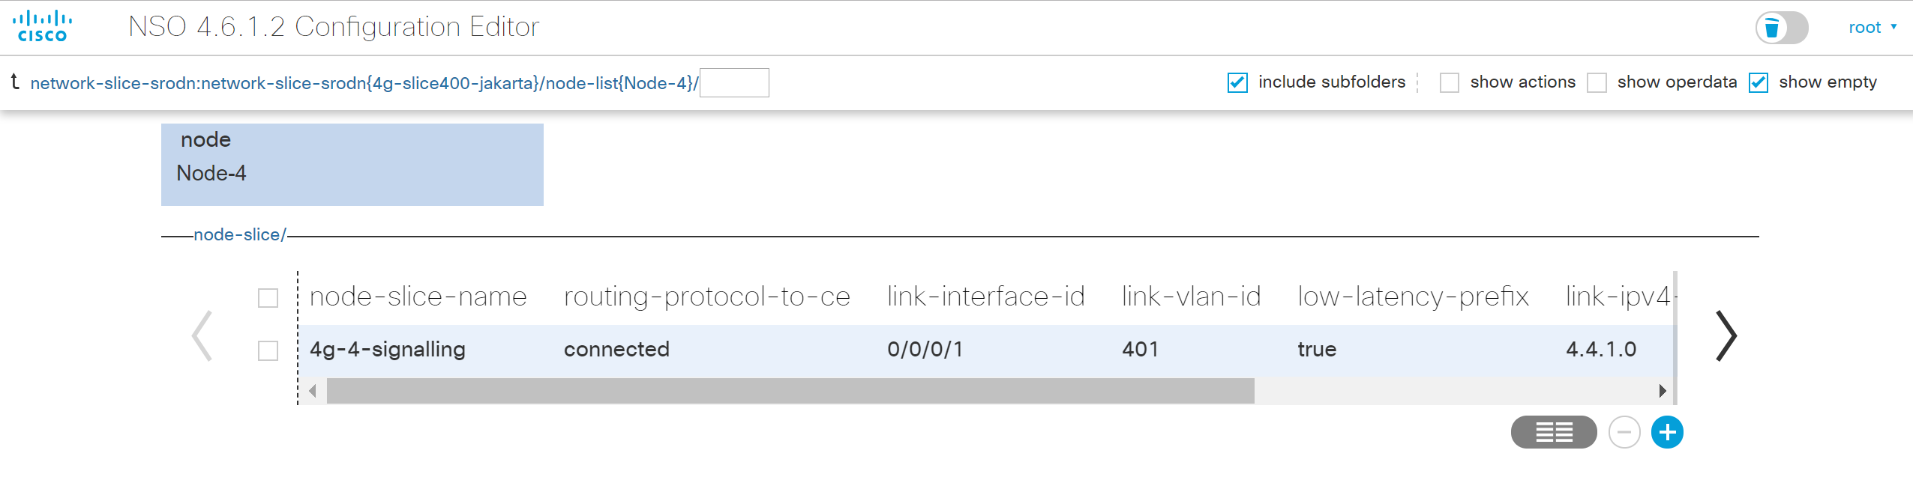
Demo SR On-Demand
Automated Steered TE Path – Low Latency Path

Slide 118
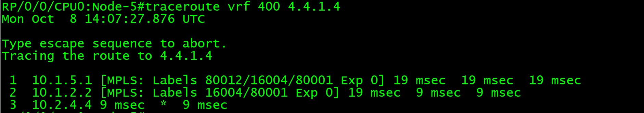
Demo SR On-Demand
Automated Steered TE Path – Low Latency Path
4g-v501-ip4-signalling
5
1
IGP = 100
1
IGP = 100
2
4g-v401-ip4-signalling
0/1
6
4

Slide 119
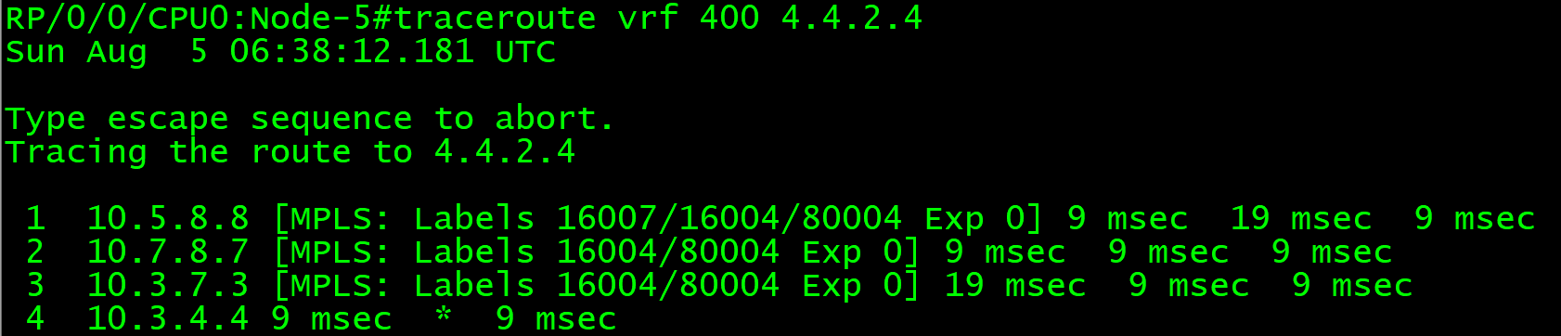

Demo Normal Joint Path
4g-v402-ip5-bearer
4g-v403-ip5-oam
5
IGP = 100
1
IGP = 100
8
3
8
3
4g-v402-ip4-bearer
4g-v402-ip6-bearer
4g-v403-ip4-oam
4g-v403-ip6-oam
IGP = 100
IGP = 100
0/1
6
7
4
7

Slide 120

Demo Disjoint-Path SLA Intent

Slide 121

Demo
Disjoint-Path SLA Intent
4g-v402-ip5-bearer
4g-v403-ip5-oam
5
1
IGP = 100
1
IGP = 100
8
3
8
3
4g-v402-ip4-bearer
4g-v402-ip6-bearer
4g-v403-ip4-oam
4g-v403-ip6-oam
IGP = 100
IGP = 100
0/1
6
7
4
7

Slide 122


Demo Low-Latency SLA Path for Critical Service Traffic

Slide 123


Slide 124


Demo
Low-Latency SLA Path
For Critical Service Traffic
4g-v401-ip5-signalling
0/1
5
1
IGP = 100
1
IGP = 100
2
8
3
4g-v401-ip4-signalling
4g-v401-ip6-signalling
IGP = 100
IGP = 100
0/1
6
7
4
7

Slide 125


Demo Link Failure Incident
Automated TE Path Reroute
4g-v401-ip5-signalling
0/1
5
1
IGP = 100
1
IGP = 100
8
3
8
4g-v401-ip4-signalling
IGP = 100
IGP = 100
0/1
7
4
7

Slide 126


Demo High Delay Link Incident
Automated TE Path Reroute
4g-v401-ip5-signalling
0/1
5
1
IGP = 100
1
IGP = 100
8
3
8
4g-v401-ip4-signalling
IGP = 100
IGP = 100
0/1
6
7
4
7

Slide 127

Demo Apply Low Latency SLA Path for All Network Slice Traffic Service

Slide 128


Demo Low Latency SLA Path
For All Service Traffic
4g-v401-ip5-signalling
0/1
4g-v402-ip5-bearer
4g-v403-ip5-oam
5
1
IGP = 100
1
IGP = 100
4g-v401-ip4-signalling
4g-v401-ip6-signalling
8
3
8
4g-v402-ip4-bearer
4g-v402-ip6-bearer
4g-v403-ip4-oam
4g-v403-ip6-oam
0/0
0/1
IGP = 100
IGP = 100
6
7
4
7

Slide 129
Thank You

